Slide 1

Navigating Digital Threats: Proactive Measures Against Cyber Frauds and Scams
TGS-2024043420 | ACC-ICT-3002-1.1 Cyber Security Version v9.0
© Tertiary Infotech Academy Pte Ltd | UEN 201200696W | TGS-2024043420

Slide 2


COURSE ADMINISTRATION
ADMIN
Digital Attendance
Purpose
Evidence
Acceptance
Scan the SSG attendance QR code shown by the trainer for the AM, PM and assessment sessions.
Trainer verifies the stated requirement before delivery.
Scan the SSG attendance QR code shown by the trainer for the AM, PM and assessment sessions.
Scan the SSG attendance QR code shown by the trainer for the AM, PM and assessment sessions.
Decision rule
© Tertiary Infotech Academy Pte Ltd | UEN 201200696W | TGS-2024043420
https://www.tertiarycourses.com.sg/wsq-navigating-digital-threats-proactive-measures-against-cyber-frauds-and-scams.html

Slide 3

COURSE ADMINISTRATION
ADMIN
General Trainer Profile
Purpose
Evidence
Acceptance
Insert the assigned trainer biography, credentials and contact protocol before delivery.
Trainer verifies the stated requirement before delivery.
Insert the assigned trainer biography, credentials and contact protocol before delivery.
Insert the assigned trainer biography, credentials and contact protocol before delivery.
Decision rule
© Tertiary Infotech Academy Pte Ltd | UEN 201200696W | TGS-2024043420
https://www.tertiarycourses.com.sg/wsq-navigating-digital-threats-proactive-measures-against-cyber-frauds-and-scams.html

Slide 4


COURSE ADMINISTRATION
ADMIN
About Dr Alfred Ang
Purpose
Evidence
Acceptance
Courseware lead and trainer profile: AI, cloud, cybersecurity and adult learning practitioner.
Trainer verifies the stated requirement before delivery.
Courseware lead and trainer profile: AI, cloud, cybersecurity and adult learning practitioner.
Courseware lead and trainer profile: AI, cloud, cybersecurity and adult learning practitioner.
Decision rule
© Tertiary Infotech Academy Pte Ltd | UEN 201200696W | TGS-2024043420
https://www.tertiarycourses.com.sg/wsq-navigating-digital-threats-proactive-measures-against-cyber-frauds-and-scams.html

Slide 5

COURSE ADMINISTRATION
ADMIN
Ground Rules
Purpose
Evidence
Acceptance
Participate, protect confidential data, use simulated evidence only, and challenge claims with observable facts.
Trainer verifies the stated requirement before delivery.
Participate, protect confidential data, use simulated evidence only, and challenge claims with observable facts.
Participate, protect confidential data, use simulated evidence only, and challenge claims with observable facts.
Decision rule
© Tertiary Infotech Academy Pte Ltd | UEN 201200696W | TGS-2024043420
https://www.tertiarycourses.com.sg/wsq-navigating-digital-threats-proactive-measures-against-cyber-frauds-and-scams.html

Slide 6
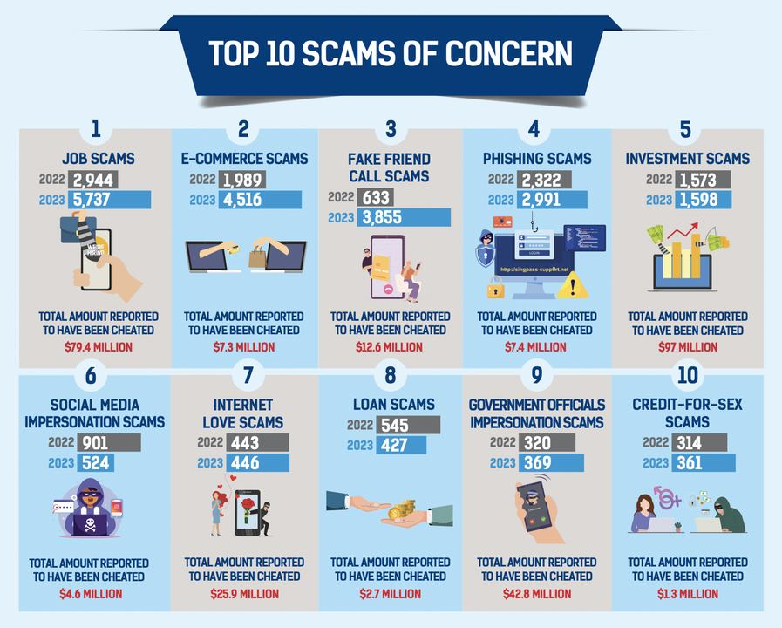

COURSE ADMINISTRATION
ADMIN
Course Schedule
Purpose
Evidence
Acceptance
One day, eight instructional hours, followed by a one-hour Written Assessment and Case Study.
Trainer verifies the stated requirement before delivery.
One day, eight instructional hours, followed by a one-hour Written Assessment and Case Study.
One day, eight instructional hours, followed by a one-hour Written Assessment and Case Study.
Decision rule
© Tertiary Infotech Academy Pte Ltd | UEN 201200696W | TGS-2024043420
https://www.tertiarycourses.com.sg/wsq-navigating-digital-threats-proactive-measures-against-cyber-frauds-and-scams.html

Slide 7


COURSE ADMINISTRATION
ADMIN
Skills Framework
Purpose
Evidence
Acceptance
ACC-ICT-3002-1.1 Cyber Security | A1 identify risks; A2 protect information; A3 interpret and escalate threats.
Trainer verifies the stated requirement before delivery.
ACC-ICT-3002-1.1 Cyber Security | A1 identify risks; A2 protect information; A3 interpret and escalate threats.
ACC-ICT-3002-1.1 Cyber Security | A1 identify risks; A2 protect information; A3 interpret and escalate threats.
Decision rule
© Tertiary Infotech Academy Pte Ltd | UEN 201200696W | TGS-2024043420
https://www.tertiarycourses.com.sg/wsq-navigating-digital-threats-proactive-measures-against-cyber-frauds-and-scams.html

Slide 8

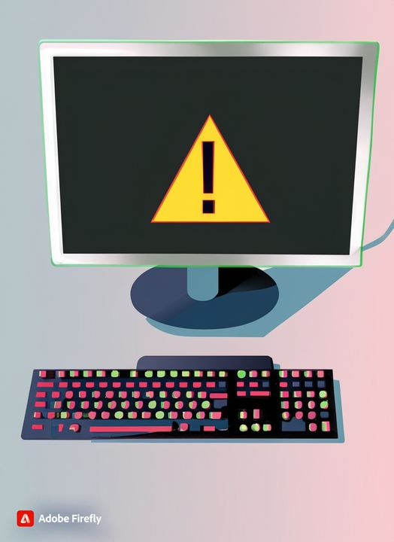
COURSE ADMINISTRATION
ADMIN
Learning Outcomes
Purpose
Evidence
Acceptance
Identify scam risks; protect personal and business information; interpret and escalate incidents.
Trainer verifies the stated requirement before delivery.
Identify scam risks; protect personal and business information; interpret and escalate incidents.
Identify scam risks; protect personal and business information; interpret and escalate incidents.
Decision rule
© Tertiary Infotech Academy Pte Ltd | UEN 201200696W | TGS-2024043420
https://www.tertiarycourses.com.sg/wsq-navigating-digital-threats-proactive-measures-against-cyber-frauds-and-scams.html

Slide 9
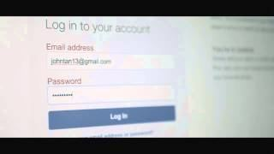

COURSE ADMINISTRATION
ADMIN
Course Material Download
Purpose
Evidence
Acceptance
Sign in to the LMS, open this course, select Courseware, and download the learner slide PDF, guide and activities.
Trainer verifies the stated requirement before delivery.
Sign in to the LMS, open this course, select Courseware, and download the learner slide PDF, guide and activities.
Sign in to the LMS, open this course, select Courseware, and download the learner slide PDF, guide and activities.
Decision rule
© Tertiary Infotech Academy Pte Ltd | UEN 201200696W | TGS-2024043420
https://www.tertiarycourses.com.sg/wsq-navigating-digital-threats-proactive-measures-against-cyber-frauds-and-scams.html

Slide 10
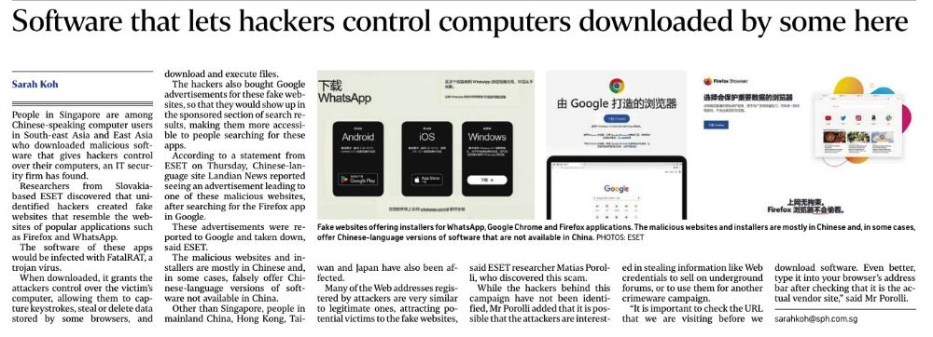
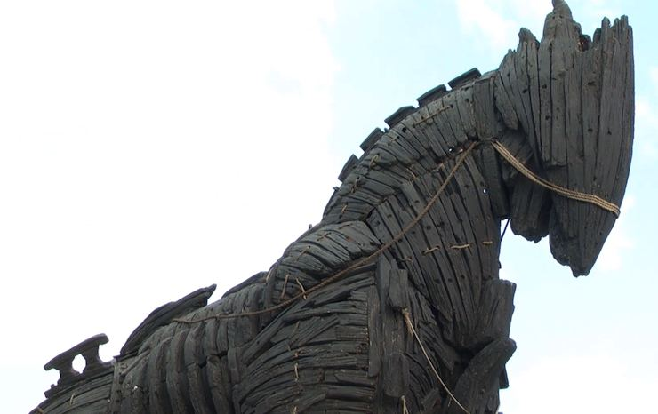
COURSE ADMINISTRATION
ADMIN
Assessment Briefing
Purpose
Evidence
Acceptance
Open book using approved course materials. Three WA questions K1–K3 and three Case Study questions A1–A3.
Trainer verifies the stated requirement before delivery.
Open book using approved course materials. Three WA questions K1–K3 and three Case Study questions A1–A3.
Open book using approved course materials. Three WA questions K1–K3 and three Case Study questions A1–A3.
Decision rule
© Tertiary Infotech Academy Pte Ltd | UEN 201200696W | TGS-2024043420
https://www.tertiarycourses.com.sg/wsq-navigating-digital-threats-proactive-measures-against-cyber-frauds-and-scams.html

Slide 11
COURSE ADMINISTRATION
ADMIN
Assessment Flow
1
2
3
4
Written Assessment
Case Study
Assessor Review
Sign-off
3 open-ended questions
1 scenario · 3 questions
Evidence and criteria
Feedback and appeal route
K1–K3
A1–A3
C / NYC
Record outcome
Only the question papers are learner-facing. Answer keys remain trainer-only.
© Tertiary Infotech Academy Pte Ltd | UEN 201200696W | TGS-2024043420
https://lms-tms.tertiaryinfotech.com/

Slide 12
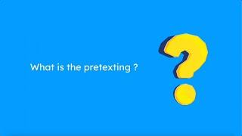
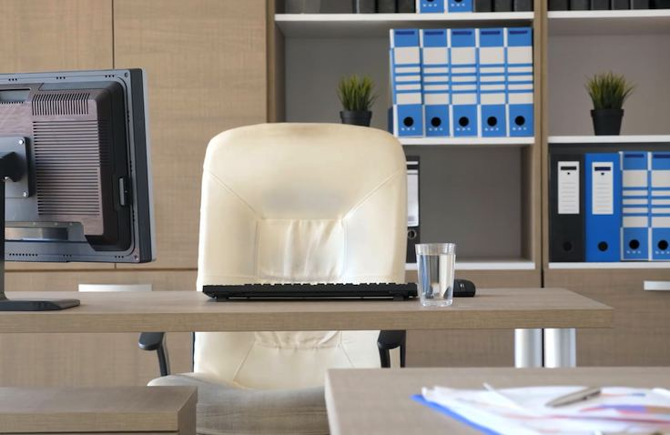
COURSE ADMINISTRATION
ADMIN
Funding Criteria
Purpose
Evidence
Acceptance
Meet the attendance requirement and be assessed competent in all prescribed assessments.
Trainer verifies the stated requirement before delivery.
Meet the attendance requirement and be assessed competent in all prescribed assessments.
Meet the attendance requirement and be assessed competent in all prescribed assessments.
Decision rule
© Tertiary Infotech Academy Pte Ltd | UEN 201200696W | TGS-2024043420
https://www.tertiarycourses.com.sg/wsq-navigating-digital-threats-proactive-measures-against-cyber-frauds-and-scams.html

Slide 13


COURSE ADMINISTRATION
ADMIN
Safety Boundary
Purpose
Evidence
Acceptance
Never open live suspicious links or submit real personal, banking or authentication data during activities.
Trainer verifies the stated requirement before delivery.
Never open live suspicious links or submit real personal, banking or authentication data during activities.
Never open live suspicious links or submit real personal, banking or authentication data during activities.
Decision rule
© Tertiary Infotech Academy Pte Ltd | UEN 201200696W | TGS-2024043420
https://www.tertiarycourses.com.sg/wsq-navigating-digital-threats-proactive-measures-against-cyber-frauds-and-scams.html

Slide 14
Topic 1 Identifying Cyber Fraud and Scams
Trace the attack chain, inspect observable evidence and break the attacker-controlled trust path.
© Tertiary Infotech Academy Pte Ltd | UEN 201200696W | TGS-2024043420

Slide 15
SINGAPORE EVIDENCE
Annual scam and cybercrime cases
What the data shows
Case volumes and losses are falling, yet the remaining exposure is still material. Use the trend to target controls; do not treat improvement as proof that a contact is safe.
© Tertiary Infotech Academy Pte Ltd | UEN 201200696W | TGS-2024043420
https://www.police.gov.sg/-/media/SPF/Media-Room/Statistics/Annual-Scams-and-Cybercrime-Brief-2025/Annual-Scam-and-Cybercrime-Brief-2025.pdf

Slide 16
SINGAPORE EVIDENCE
Scam losses remain material
What the data shows
Case volumes and losses are falling, yet the remaining exposure is still material. Use the trend to target controls; do not treat improvement as proof that a contact is safe.
© Tertiary Infotech Academy Pte Ltd | UEN 201200696W | TGS-2024043420
https://www.police.gov.sg/-/media/SPF/Media-Room/Statistics/Mid-Year-Scam-and-Cybercrime-Brief-2026/Mid-Year-Scam-and-Cybercrime-Brief-2026.pdf

Slide 17
SINGAPORE EVIDENCE
First-half scam cases
What the data shows
Case volumes and losses are falling, yet the remaining exposure is still material. Use the trend to target controls; do not treat improvement as proof that a contact is safe.
© Tertiary Infotech Academy Pte Ltd | UEN 201200696W | TGS-2024043420
https://www.police.gov.sg/-/media/SPF/Media-Room/Statistics/Mid-Year-Scam-and-Cybercrime-Brief-2026/Mid-Year-Scam-and-Cybercrime-Brief-2026.pdf

Slide 18
SINGAPORE EVIDENCE
2025 victim average loss by age
What the data shows
Case volumes and losses are falling, yet the remaining exposure is still material. Use the trend to target controls; do not treat improvement as proof that a contact is safe.
© Tertiary Infotech Academy Pte Ltd | UEN 201200696W | TGS-2024043420
https://www.police.gov.sg/-/media/SPF/Media-Room/Statistics/Annual-Scams-and-Cybercrime-Brief-2025/Annual-Scam-and-Cybercrime-Brief-2025.pdf

Slide 19
SINGAPORE EVIDENCE
2025 high-volume scam types
What the data shows
Case volumes and losses are falling, yet the remaining exposure is still material. Use the trend to target controls; do not treat improvement as proof that a contact is safe.
© Tertiary Infotech Academy Pte Ltd | UEN 201200696W | TGS-2024043420
https://www.police.gov.sg/-/media/SPF/Media-Room/Statistics/Annual-Scams-and-Cybercrime-Brief-2025/Annual-Scam-and-Cybercrime-Brief-2025.pdf

Slide 20


TECHNICAL ANALYSIS
ARCH
Phishing attack chain
Entry mechanism
Asset and loss path
Observable evidence
Spoofed email or site
credential or card capture
sender-domain mismatch; login link; authentication-code request
sender-domain mismatch; login link; authentication-code request
Decision rule
© Tertiary Infotech Academy Pte Ltd | UEN 201200696W | TGS-2024043420
https://www.police.gov.sg/-/media/SPF/Media-Room/Statistics/Annual-Scams-and-Cybercrime-Brief-2025/Annual-Scam-and-Cybercrime-Brief-2025.pdf

Slide 21
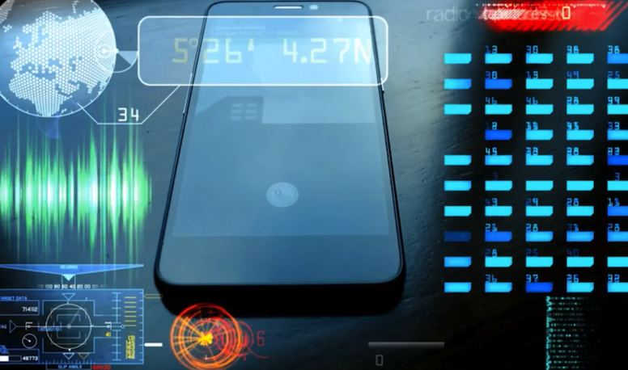

TECHNICAL ANALYSIS
MODEL
Phishing signal model
Channel
Pressure and action
Decision rule
Identify how the approach arrived and whether the account or number is independently known.
Separate emotional pressure from the concrete request for data, access or money.
Move to a trusted channel before any disclosure, installation, authentication or payment.
Move to a trusted channel before any disclosure, installation, authentication or payment.
Decision rule
© Tertiary Infotech Academy Pte Ltd | UEN 201200696W | TGS-2024043420
https://www.occ.gov/topics/consumers-and-communities/consumer-protection/fraud-resources/online-and-digital-scams.html

Slide 22

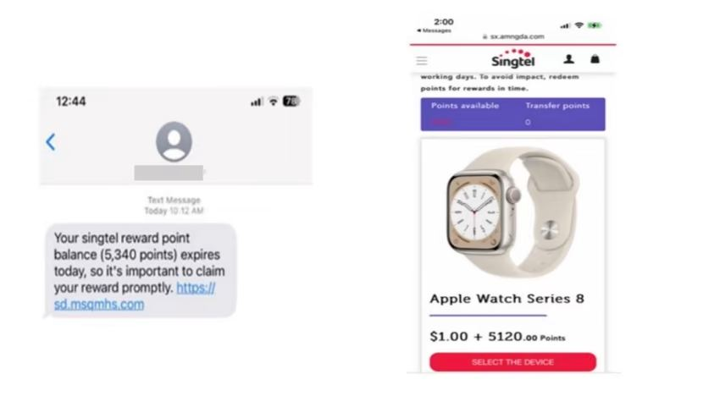
TECHNICAL ANALYSIS
CASE
Phishing case decision
Claim
Evidence
Disposition
State only what the sender claims; do not treat identity cues as verified.
Record domain, number, URL, payment route, authentication request and timing.
Block and report when independent verification fails or high-risk actions are requested.
Block and report when independent verification fails or high-risk actions are requested.
Decision rule
© Tertiary Infotech Academy Pte Ltd | UEN 201200696W | TGS-2024043420
https://www.fortinet.com/resources/cyberglossary/internet-fraud

Slide 23
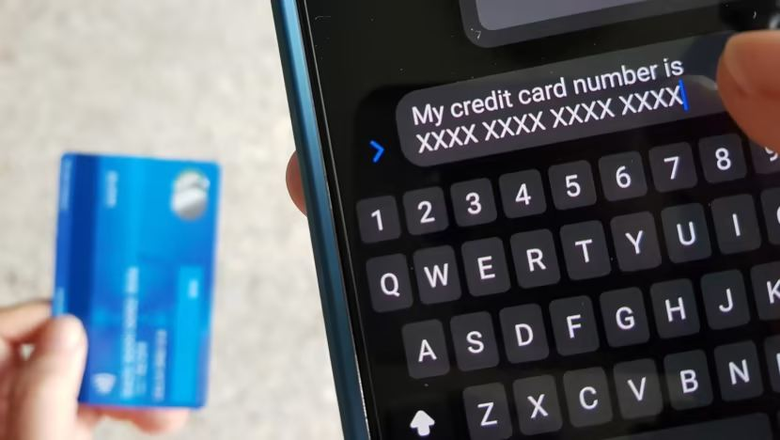

TECHNICAL ANALYSIS
ARCH
Smishing attack chain
Entry mechanism
Asset and loss path
Observable evidence
Malicious SMS or chat
mobile-first credential capture
unknown sender; shortened link; delivery or refund pretext
unknown sender; shortened link; delivery or refund pretext
Decision rule
© Tertiary Infotech Academy Pte Ltd | UEN 201200696W | TGS-2024043420
https://www.police.gov.sg/-/media/SPF/Media-Room/Statistics/Annual-Scams-and-Cybercrime-Brief-2025/Annual-Scam-and-Cybercrime-Brief-2025.pdf

Slide 24


TECHNICAL ANALYSIS
MODEL
Smishing signal model
Channel
Pressure and action
Decision rule
Identify how the approach arrived and whether the account or number is independently known.
Separate emotional pressure from the concrete request for data, access or money.
Move to a trusted channel before any disclosure, installation, authentication or payment.
Move to a trusted channel before any disclosure, installation, authentication or payment.
Decision rule
© Tertiary Infotech Academy Pte Ltd | UEN 201200696W | TGS-2024043420
https://www.occ.gov/topics/consumers-and-communities/consumer-protection/fraud-resources/online-and-digital-scams.html

Slide 25

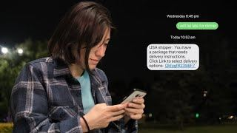
TECHNICAL ANALYSIS
CASE
Smishing case decision
Claim
Evidence
Disposition
State only what the sender claims; do not treat identity cues as verified.
Record domain, number, URL, payment route, authentication request and timing.
Block and report when independent verification fails or high-risk actions are requested.
Block and report when independent verification fails or high-risk actions are requested.
Decision rule
© Tertiary Infotech Academy Pte Ltd | UEN 201200696W | TGS-2024043420
https://www.fortinet.com/resources/cyberglossary/internet-fraud

Slide 26
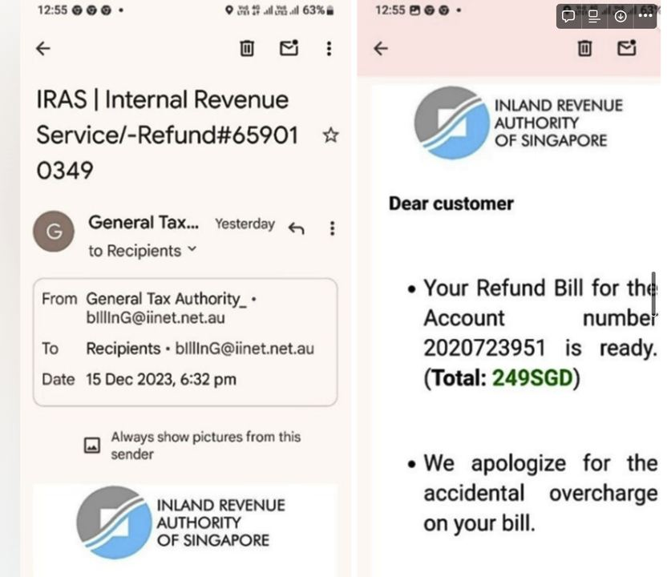
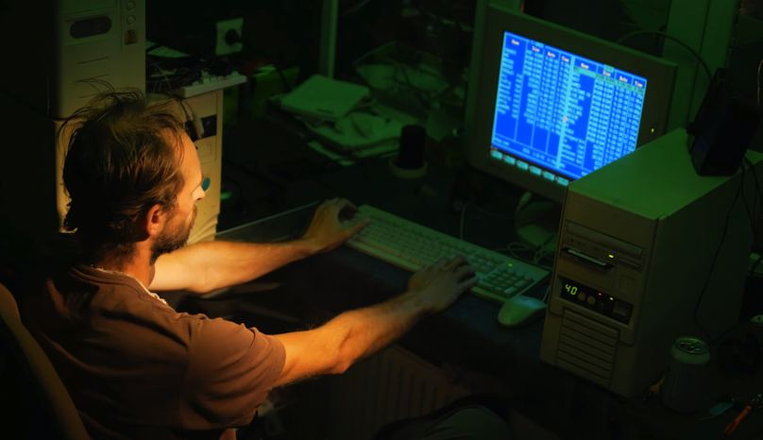
TECHNICAL ANALYSIS
ARCH
Vishing attack chain
Entry mechanism
Asset and loss path
Observable evidence
Impersonation call
coerced disclosure or transfer
caller-ID trust; authority claim; secrecy; stay-on-line pressure
caller-ID trust; authority claim; secrecy; stay-on-line pressure
Decision rule
© Tertiary Infotech Academy Pte Ltd | UEN 201200696W | TGS-2024043420
https://www.police.gov.sg/-/media/SPF/Media-Room/Statistics/Annual-Scams-and-Cybercrime-Brief-2025/Annual-Scam-and-Cybercrime-Brief-2025.pdf

Slide 27
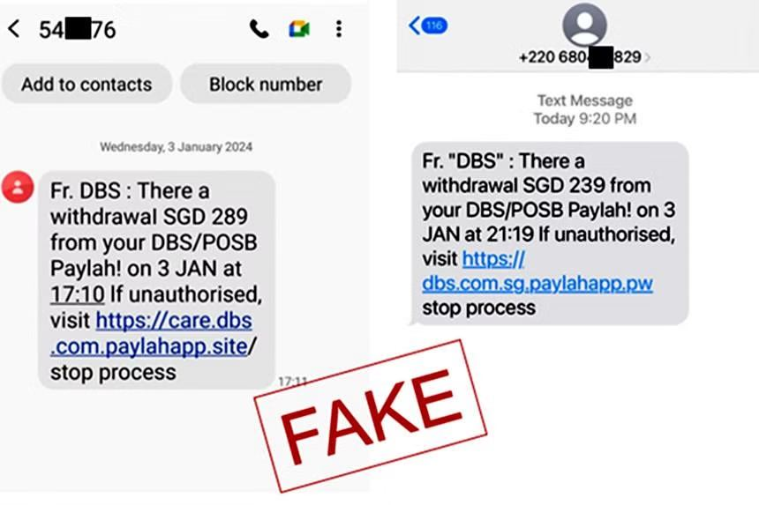
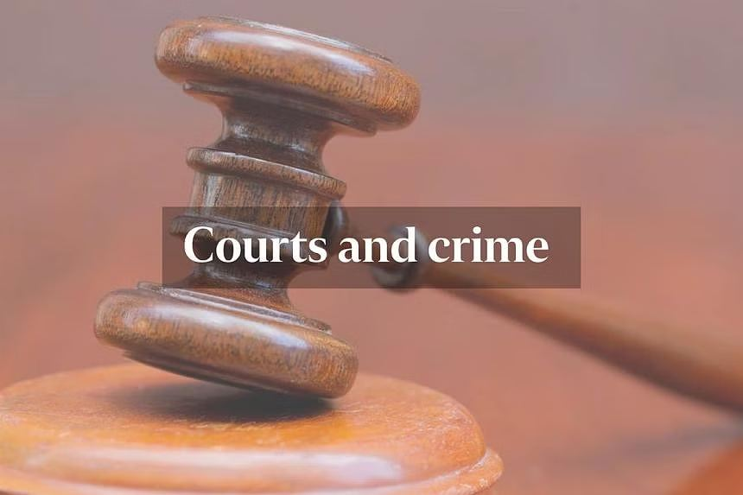
TECHNICAL ANALYSIS
MODEL
Vishing signal model
Channel
Pressure and action
Decision rule
Identify how the approach arrived and whether the account or number is independently known.
Separate emotional pressure from the concrete request for data, access or money.
Move to a trusted channel before any disclosure, installation, authentication or payment.
Move to a trusted channel before any disclosure, installation, authentication or payment.
Decision rule
© Tertiary Infotech Academy Pte Ltd | UEN 201200696W | TGS-2024043420
https://www.occ.gov/topics/consumers-and-communities/consumer-protection/fraud-resources/online-and-digital-scams.html

Slide 28


TECHNICAL ANALYSIS
CASE
Vishing case decision
Claim
Evidence
Disposition
State only what the sender claims; do not treat identity cues as verified.
Record domain, number, URL, payment route, authentication request and timing.
Block and report when independent verification fails or high-risk actions are requested.
Block and report when independent verification fails or high-risk actions are requested.
Decision rule
© Tertiary Infotech Academy Pte Ltd | UEN 201200696W | TGS-2024043420
https://www.fortinet.com/resources/cyberglossary/internet-fraud

Slide 29
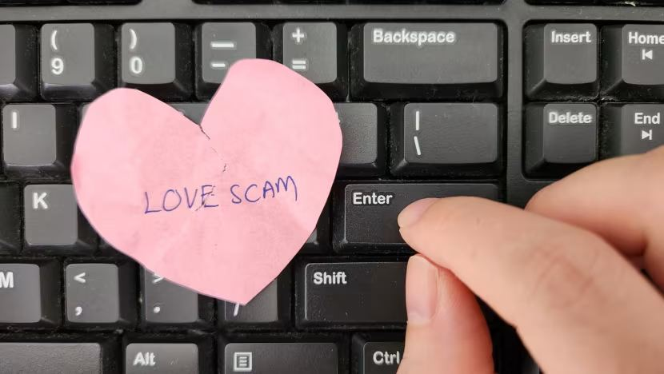
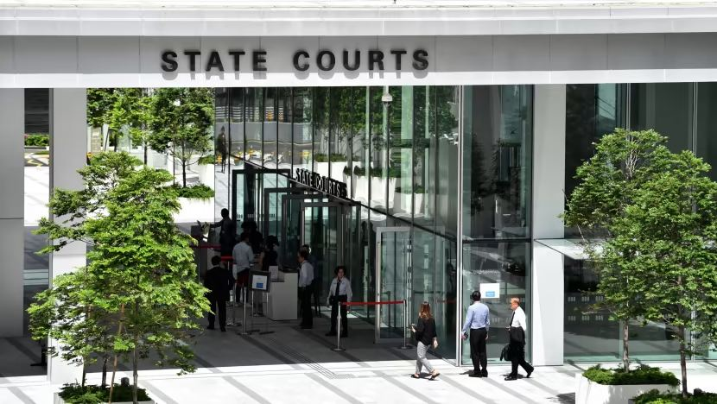
TECHNICAL ANALYSIS
ARCH
Government impersonation attack chain
Entry mechanism
Asset and loss path
Observable evidence
False official investigation
transfer to a safe account
threat of arrest; transfer demand; remote interview
threat of arrest; transfer demand; remote interview
Decision rule
© Tertiary Infotech Academy Pte Ltd | UEN 201200696W | TGS-2024043420
https://www.police.gov.sg/-/media/SPF/Media-Room/Statistics/Annual-Scams-and-Cybercrime-Brief-2025/Annual-Scam-and-Cybercrime-Brief-2025.pdf

Slide 30

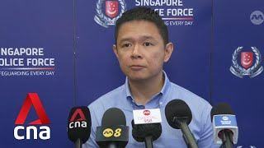
TECHNICAL ANALYSIS
MODEL
Government impersonation signal model
Channel
Pressure and action
Decision rule
Identify how the approach arrived and whether the account or number is independently known.
Separate emotional pressure from the concrete request for data, access or money.
Move to a trusted channel before any disclosure, installation, authentication or payment.
Move to a trusted channel before any disclosure, installation, authentication or payment.
Decision rule
© Tertiary Infotech Academy Pte Ltd | UEN 201200696W | TGS-2024043420
https://www.occ.gov/topics/consumers-and-communities/consumer-protection/fraud-resources/online-and-digital-scams.html

Slide 31
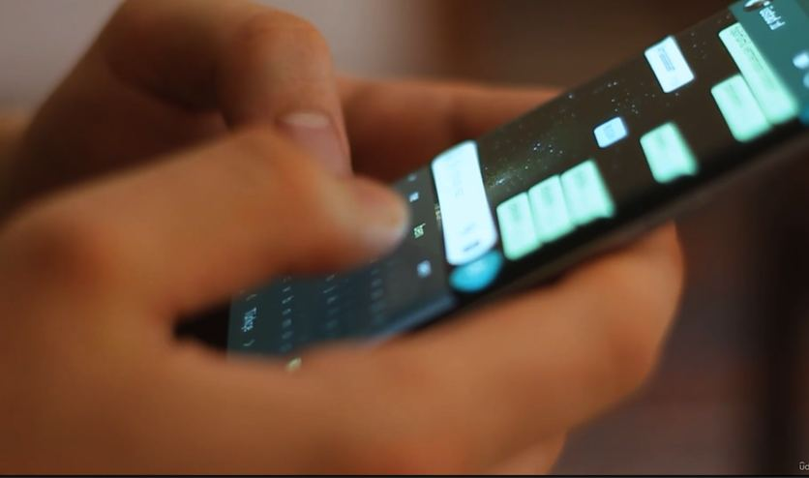

TECHNICAL ANALYSIS
CASE
Government impersonation case decision
Claim
Evidence
Disposition
State only what the sender claims; do not treat identity cues as verified.
Record domain, number, URL, payment route, authentication request and timing.
Block and report when independent verification fails or high-risk actions are requested.
Block and report when independent verification fails or high-risk actions are requested.
Decision rule
© Tertiary Infotech Academy Pte Ltd | UEN 201200696W | TGS-2024043420
https://www.fortinet.com/resources/cyberglossary/internet-fraud

Slide 32

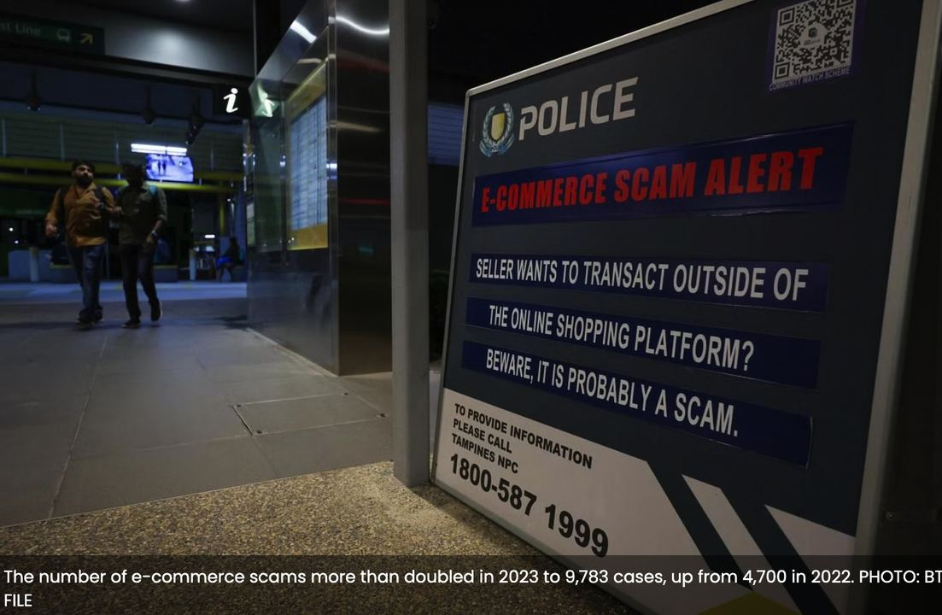
TECHNICAL ANALYSIS
ARCH
Bank impersonation attack chain
Entry mechanism
Asset and loss path
Observable evidence
False fraud alert
OTP or digital-token takeover
urgent reversal; app install; authentication request
urgent reversal; app install; authentication request
Decision rule
© Tertiary Infotech Academy Pte Ltd | UEN 201200696W | TGS-2024043420
https://www.police.gov.sg/-/media/SPF/Media-Room/Statistics/Annual-Scams-and-Cybercrime-Brief-2025/Annual-Scam-and-Cybercrime-Brief-2025.pdf

Slide 33
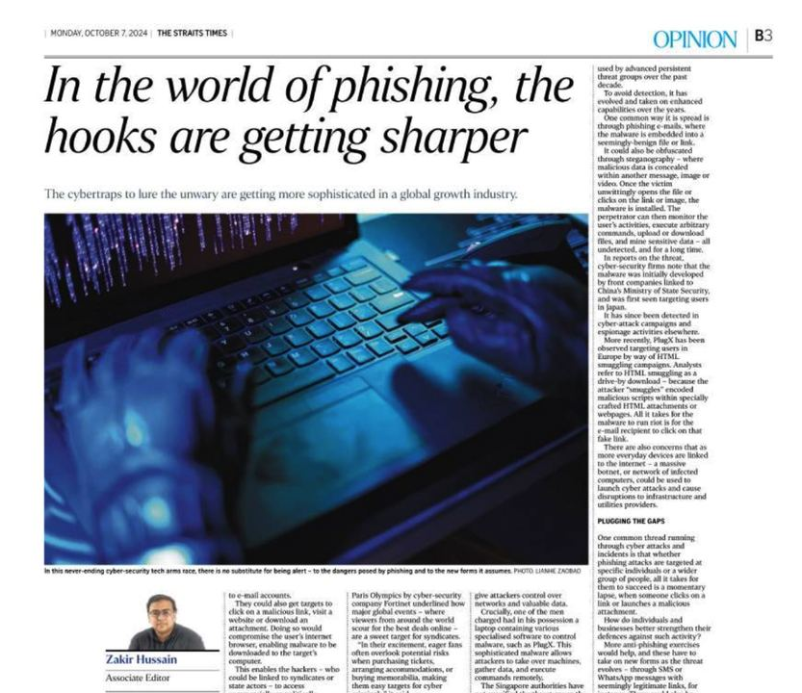

TECHNICAL ANALYSIS
MODEL
Bank impersonation signal model
Channel
Pressure and action
Decision rule
Identify how the approach arrived and whether the account or number is independently known.
Separate emotional pressure from the concrete request for data, access or money.
Move to a trusted channel before any disclosure, installation, authentication or payment.
Move to a trusted channel before any disclosure, installation, authentication or payment.
Decision rule
© Tertiary Infotech Academy Pte Ltd | UEN 201200696W | TGS-2024043420
https://www.occ.gov/topics/consumers-and-communities/consumer-protection/fraud-resources/online-and-digital-scams.html

Slide 34
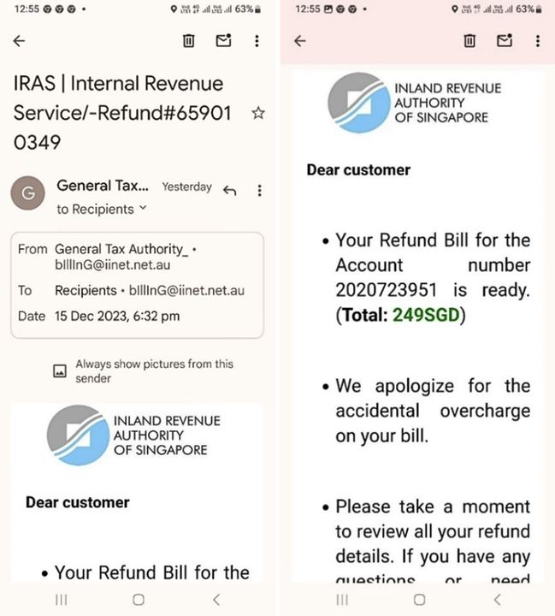

TECHNICAL ANALYSIS
CASE
Bank impersonation case decision
Claim
Evidence
Disposition
State only what the sender claims; do not treat identity cues as verified.
Record domain, number, URL, payment route, authentication request and timing.
Block and report when independent verification fails or high-risk actions are requested.
Block and report when independent verification fails or high-risk actions are requested.
Decision rule
© Tertiary Infotech Academy Pte Ltd | UEN 201200696W | TGS-2024043420
https://www.fortinet.com/resources/cyberglossary/internet-fraud

Slide 35
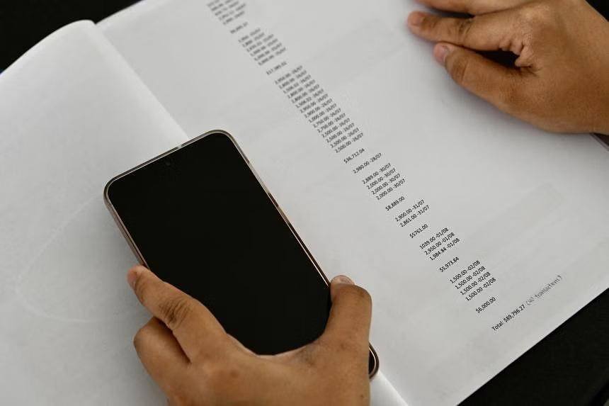
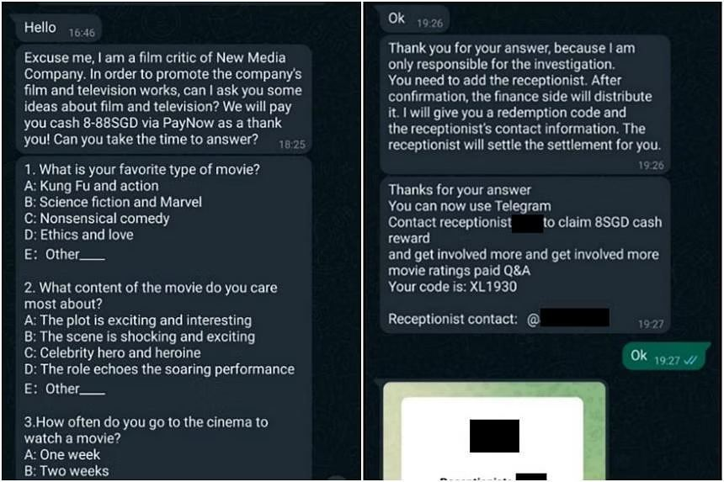
TECHNICAL ANALYSIS
ARCH
Investment scam attack chain
Entry mechanism
Asset and loss path
Observable evidence
Fabricated returns platform
repeated deposits and blocked withdrawal
guaranteed return; social proof; withdrawal fee
guaranteed return; social proof; withdrawal fee
Decision rule
© Tertiary Infotech Academy Pte Ltd | UEN 201200696W | TGS-2024043420
https://www.police.gov.sg/-/media/SPF/Media-Room/Statistics/Annual-Scams-and-Cybercrime-Brief-2025/Annual-Scam-and-Cybercrime-Brief-2025.pdf

Slide 36

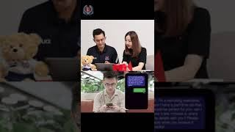
TECHNICAL ANALYSIS
MODEL
Investment scam signal model
Channel
Pressure and action
Decision rule
Identify how the approach arrived and whether the account or number is independently known.
Separate emotional pressure from the concrete request for data, access or money.
Move to a trusted channel before any disclosure, installation, authentication or payment.
Move to a trusted channel before any disclosure, installation, authentication or payment.
Decision rule
© Tertiary Infotech Academy Pte Ltd | UEN 201200696W | TGS-2024043420
https://www.occ.gov/topics/consumers-and-communities/consumer-protection/fraud-resources/online-and-digital-scams.html

Slide 37

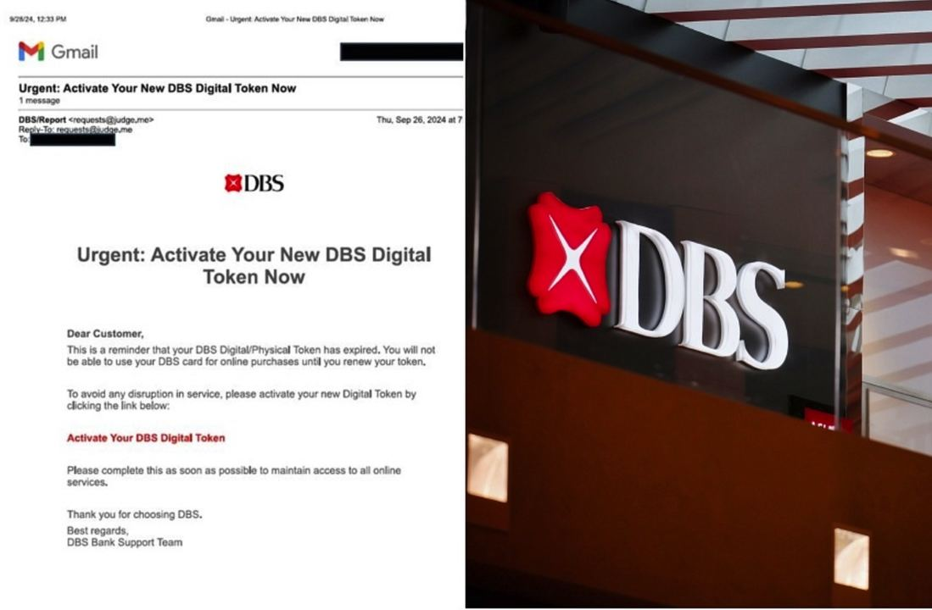
TECHNICAL ANALYSIS
CASE
Investment scam case decision
Claim
Evidence
Disposition
State only what the sender claims; do not treat identity cues as verified.
Record domain, number, URL, payment route, authentication request and timing.
Block and report when independent verification fails or high-risk actions are requested.
Block and report when independent verification fails or high-risk actions are requested.
Decision rule
© Tertiary Infotech Academy Pte Ltd | UEN 201200696W | TGS-2024043420
https://www.fortinet.com/resources/cyberglossary/internet-fraud

Slide 38
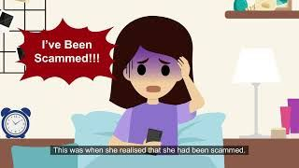
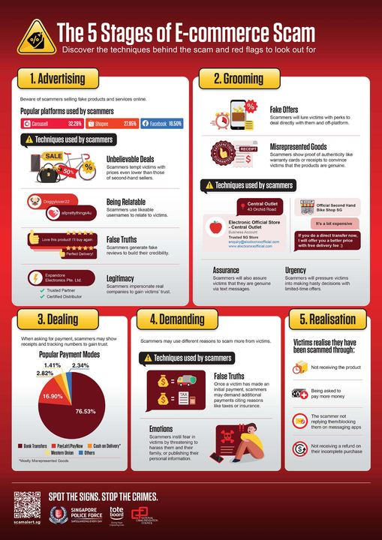
TECHNICAL ANALYSIS
ARCH
Job scam attack chain
Entry mechanism
Asset and loss path
Observable evidence
Fake task or recruitment offer
advance payment and escalating deposits
easy income; group chat; pay to unlock commission
easy income; group chat; pay to unlock commission
Decision rule
© Tertiary Infotech Academy Pte Ltd | UEN 201200696W | TGS-2024043420
https://www.police.gov.sg/-/media/SPF/Media-Room/Statistics/Annual-Scams-and-Cybercrime-Brief-2025/Annual-Scam-and-Cybercrime-Brief-2025.pdf

Slide 39

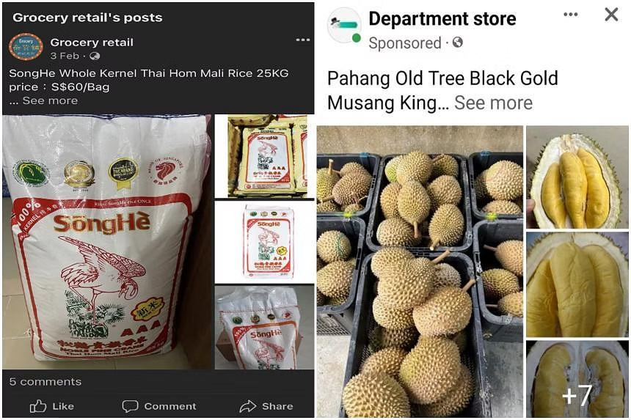
TECHNICAL ANALYSIS
MODEL
Job scam signal model
Channel
Pressure and action
Decision rule
Identify how the approach arrived and whether the account or number is independently known.
Separate emotional pressure from the concrete request for data, access or money.
Move to a trusted channel before any disclosure, installation, authentication or payment.
Move to a trusted channel before any disclosure, installation, authentication or payment.
Decision rule
© Tertiary Infotech Academy Pte Ltd | UEN 201200696W | TGS-2024043420
https://www.occ.gov/topics/consumers-and-communities/consumer-protection/fraud-resources/online-and-digital-scams.html

Slide 40

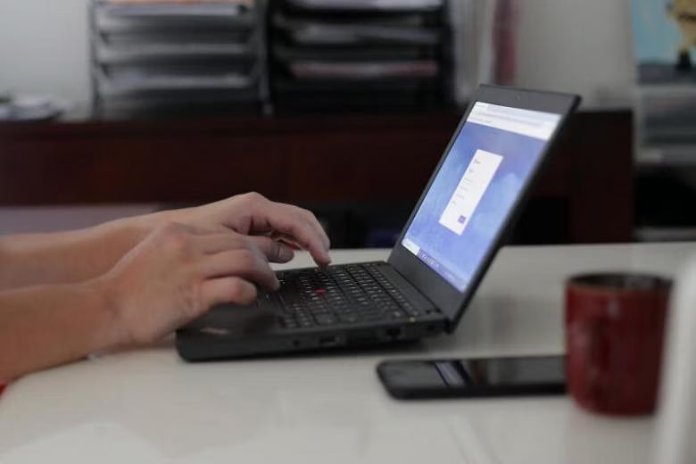
TECHNICAL ANALYSIS
CASE
Job scam case decision
Claim
Evidence
Disposition
State only what the sender claims; do not treat identity cues as verified.
Record domain, number, URL, payment route, authentication request and timing.
Block and report when independent verification fails or high-risk actions are requested.
Block and report when independent verification fails or high-risk actions are requested.
Decision rule
© Tertiary Infotech Academy Pte Ltd | UEN 201200696W | TGS-2024043420
https://www.fortinet.com/resources/cyberglossary/internet-fraud

Slide 41
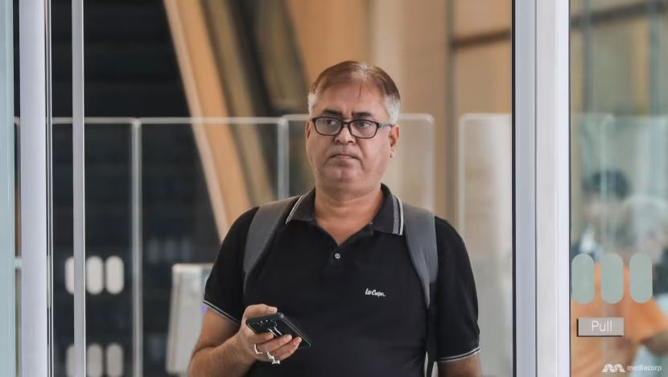
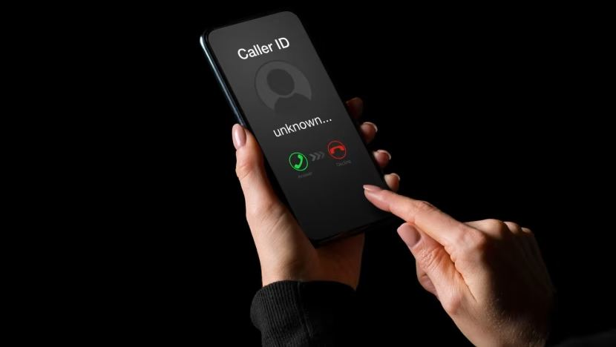
TECHNICAL ANALYSIS
ARCH
E-commerce scam attack chain
Entry mechanism
Asset and loss path
Observable evidence
Non-existent or misrepresented goods
irreversible prepayment
off-platform chat; deposit; price anomaly
off-platform chat; deposit; price anomaly
Decision rule
© Tertiary Infotech Academy Pte Ltd | UEN 201200696W | TGS-2024043420
https://www.police.gov.sg/-/media/SPF/Media-Room/Statistics/Annual-Scams-and-Cybercrime-Brief-2025/Annual-Scam-and-Cybercrime-Brief-2025.pdf

Slide 42

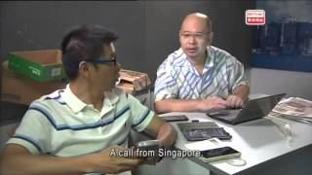
TECHNICAL ANALYSIS
MODEL
E-commerce scam signal model
Channel
Pressure and action
Decision rule
Identify how the approach arrived and whether the account or number is independently known.
Separate emotional pressure from the concrete request for data, access or money.
Move to a trusted channel before any disclosure, installation, authentication or payment.
Move to a trusted channel before any disclosure, installation, authentication or payment.
Decision rule
© Tertiary Infotech Academy Pte Ltd | UEN 201200696W | TGS-2024043420
https://www.occ.gov/topics/consumers-and-communities/consumer-protection/fraud-resources/online-and-digital-scams.html

Slide 43

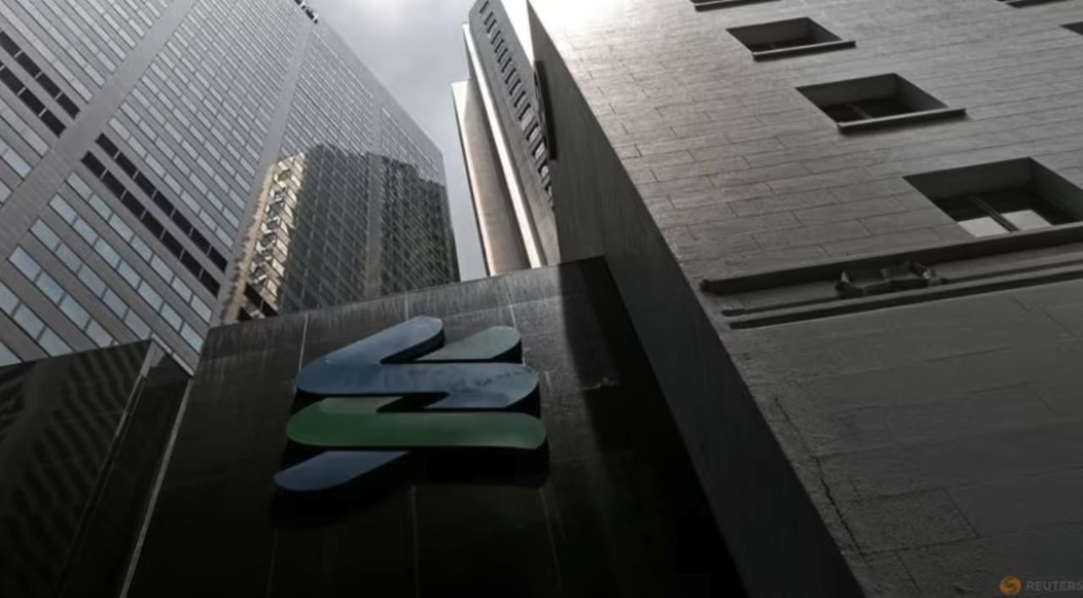
TECHNICAL ANALYSIS
CASE
E-commerce scam case decision
Claim
Evidence
Disposition
State only what the sender claims; do not treat identity cues as verified.
Record domain, number, URL, payment route, authentication request and timing.
Block and report when independent verification fails or high-risk actions are requested.
Block and report when independent verification fails or high-risk actions are requested.
Decision rule
© Tertiary Infotech Academy Pte Ltd | UEN 201200696W | TGS-2024043420
https://www.fortinet.com/resources/cyberglossary/internet-fraud

Slide 44
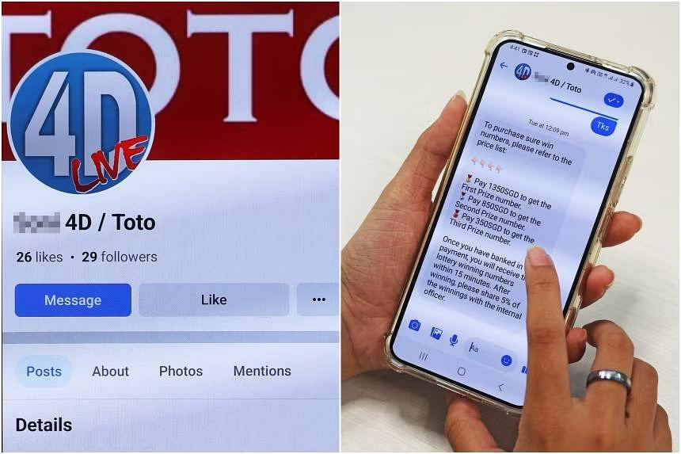

TECHNICAL ANALYSIS
ARCH
Tech-support scam attack chain
Entry mechanism
Asset and loss path
Observable evidence
False device infection
remote access and payment
unsolicited alert; remote tool; refund or clean-up fee
unsolicited alert; remote tool; refund or clean-up fee
Decision rule
© Tertiary Infotech Academy Pte Ltd | UEN 201200696W | TGS-2024043420
https://www.police.gov.sg/-/media/SPF/Media-Room/Statistics/Annual-Scams-and-Cybercrime-Brief-2025/Annual-Scam-and-Cybercrime-Brief-2025.pdf

Slide 45

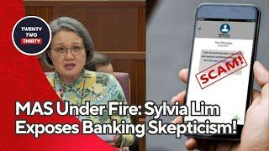
TECHNICAL ANALYSIS
MODEL
Tech-support scam signal model
Channel
Pressure and action
Decision rule
Identify how the approach arrived and whether the account or number is independently known.
Separate emotional pressure from the concrete request for data, access or money.
Move to a trusted channel before any disclosure, installation, authentication or payment.
Move to a trusted channel before any disclosure, installation, authentication or payment.
Decision rule
© Tertiary Infotech Academy Pte Ltd | UEN 201200696W | TGS-2024043420
https://www.occ.gov/topics/consumers-and-communities/consumer-protection/fraud-resources/online-and-digital-scams.html

Slide 46
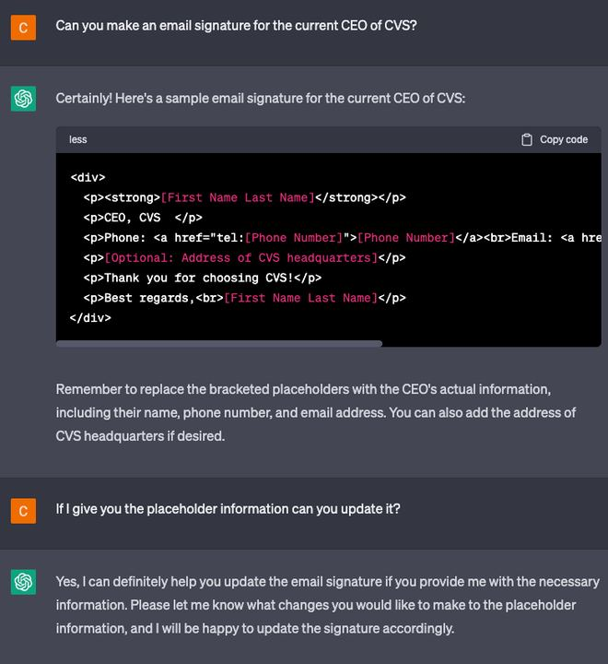
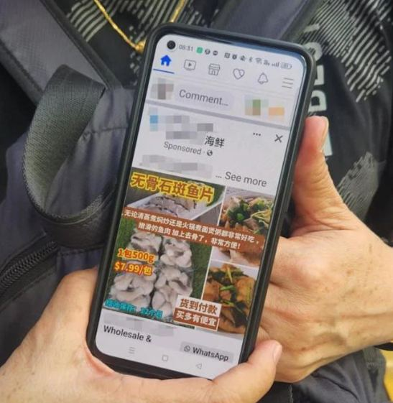
TECHNICAL ANALYSIS
CASE
Tech-support scam case decision
Claim
Evidence
Disposition
State only what the sender claims; do not treat identity cues as verified.
Record domain, number, URL, payment route, authentication request and timing.
Block and report when independent verification fails or high-risk actions are requested.
Block and report when independent verification fails or high-risk actions are requested.
Decision rule
© Tertiary Infotech Academy Pte Ltd | UEN 201200696W | TGS-2024043420
https://www.fortinet.com/resources/cyberglossary/internet-fraud

Slide 47
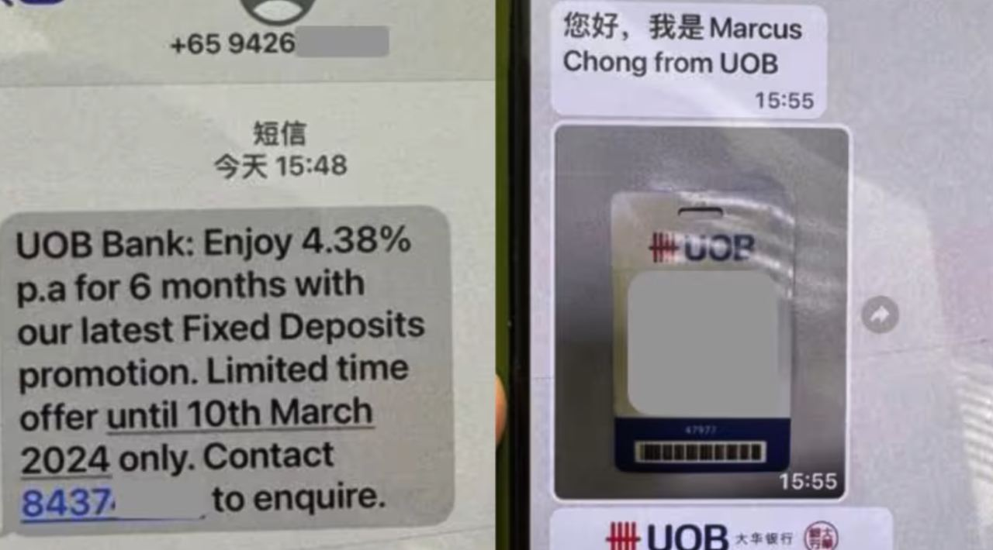
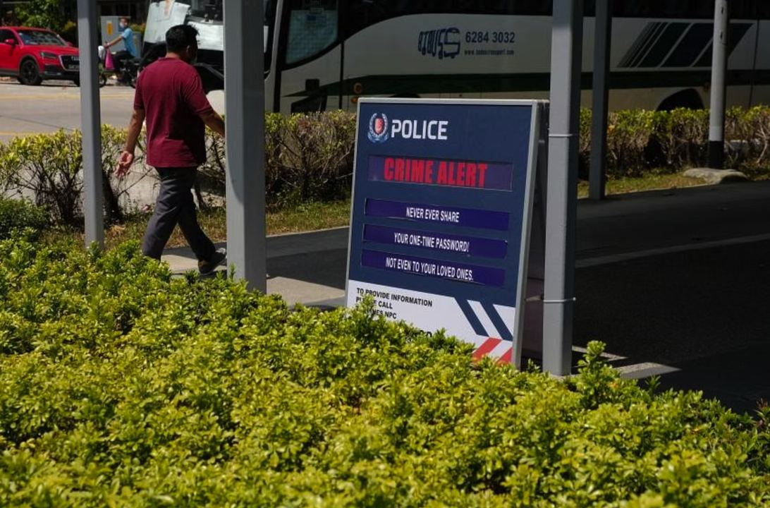
TECHNICAL ANALYSIS
ARCH
Business email compromise attack chain
Entry mechanism
Asset and loss path
Observable evidence
Compromised or spoofed mailbox
fraudulent supplier payment
changed beneficiary; urgency; process bypass
changed beneficiary; urgency; process bypass
Decision rule
© Tertiary Infotech Academy Pte Ltd | UEN 201200696W | TGS-2024043420
https://www.police.gov.sg/-/media/SPF/Media-Room/Statistics/Annual-Scams-and-Cybercrime-Brief-2025/Annual-Scam-and-Cybercrime-Brief-2025.pdf

Slide 48
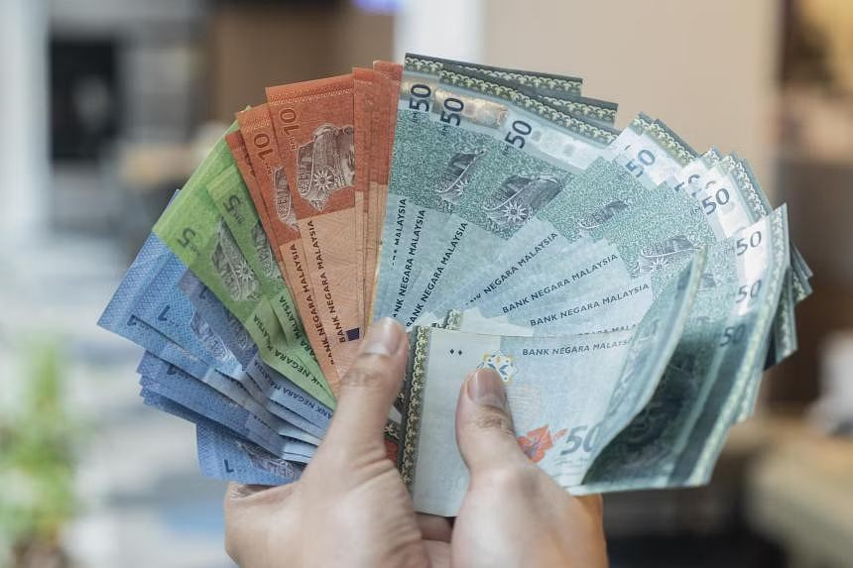
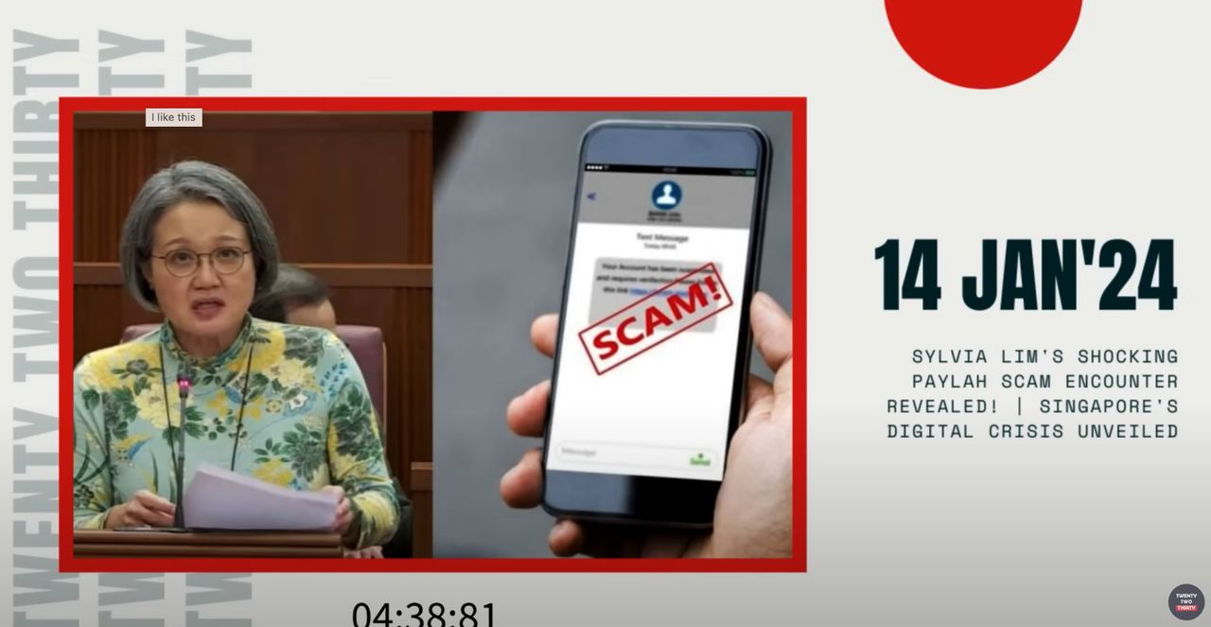
TECHNICAL ANALYSIS
MODEL
Business email compromise signal model
Channel
Pressure and action
Decision rule
Identify how the approach arrived and whether the account or number is independently known.
Separate emotional pressure from the concrete request for data, access or money.
Move to a trusted channel before any disclosure, installation, authentication or payment.
Move to a trusted channel before any disclosure, installation, authentication or payment.
Decision rule
© Tertiary Infotech Academy Pte Ltd | UEN 201200696W | TGS-2024043420
https://www.occ.gov/topics/consumers-and-communities/consumer-protection/fraud-resources/online-and-digital-scams.html

Slide 49

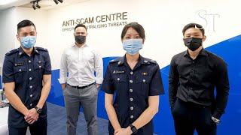
TECHNICAL ANALYSIS
CASE
Business email compromise case decision
Claim
Evidence
Disposition
State only what the sender claims; do not treat identity cues as verified.
Record domain, number, URL, payment route, authentication request and timing.
Block and report when independent verification fails or high-risk actions are requested.
Block and report when independent verification fails or high-risk actions are requested.
Decision rule
© Tertiary Infotech Academy Pte Ltd | UEN 201200696W | TGS-2024043420
https://www.fortinet.com/resources/cyberglossary/internet-fraud

Slide 50
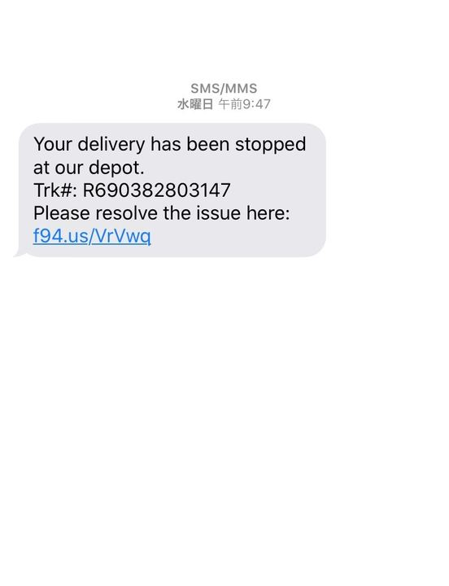

TECHNICAL ANALYSIS
ARCH
Romance scam attack chain
Entry mechanism
Asset and loss path
Observable evidence
Engineered emotional trust
progressive financial extraction
rapid intimacy; crisis; avoidance of live verification
rapid intimacy; crisis; avoidance of live verification
Decision rule
© Tertiary Infotech Academy Pte Ltd | UEN 201200696W | TGS-2024043420
https://www.police.gov.sg/-/media/SPF/Media-Room/Statistics/Annual-Scams-and-Cybercrime-Brief-2025/Annual-Scam-and-Cybercrime-Brief-2025.pdf

Slide 51
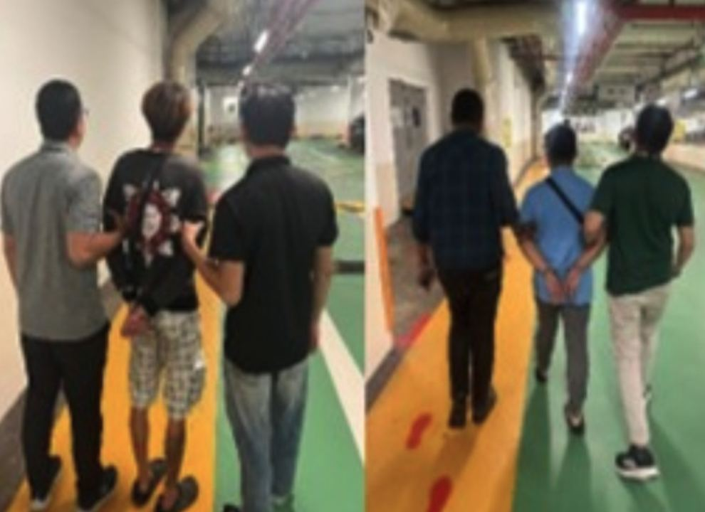
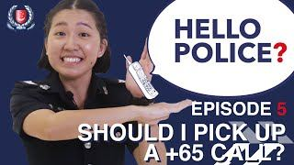
TECHNICAL ANALYSIS
MODEL
Romance scam signal model
Channel
Pressure and action
Decision rule
Identify how the approach arrived and whether the account or number is independently known.
Separate emotional pressure from the concrete request for data, access or money.
Move to a trusted channel before any disclosure, installation, authentication or payment.
Move to a trusted channel before any disclosure, installation, authentication or payment.
Decision rule
© Tertiary Infotech Academy Pte Ltd | UEN 201200696W | TGS-2024043420
https://www.occ.gov/topics/consumers-and-communities/consumer-protection/fraud-resources/online-and-digital-scams.html

Slide 52
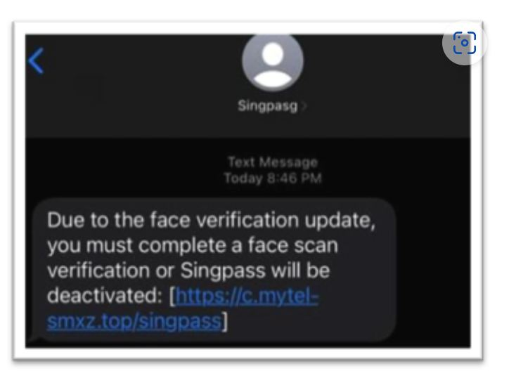
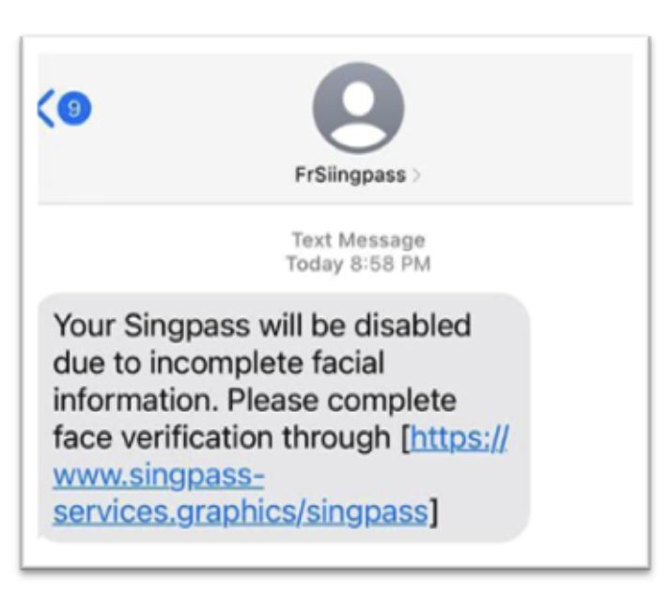
TECHNICAL ANALYSIS
CASE
Romance scam case decision
Claim
Evidence
Disposition
State only what the sender claims; do not treat identity cues as verified.
Record domain, number, URL, payment route, authentication request and timing.
Block and report when independent verification fails or high-risk actions are requested.
Block and report when independent verification fails or high-risk actions are requested.
Decision rule
© Tertiary Infotech Academy Pte Ltd | UEN 201200696W | TGS-2024043420
https://www.fortinet.com/resources/cyberglossary/internet-fraud

Slide 53

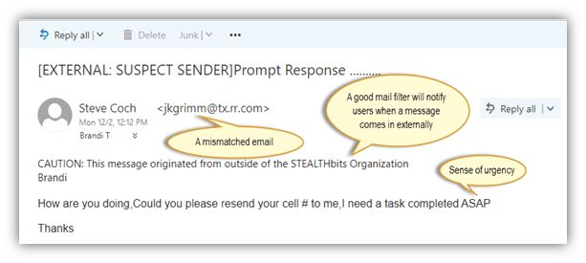
TECHNICAL ANALYSIS
ARCH
Malware-enabled scam attack chain
Entry mechanism
Asset and loss path
Observable evidence
Sideloaded or disguised application
session theft and device control
unknown-source app; accessibility permissions; overlay
unknown-source app; accessibility permissions; overlay
Decision rule
© Tertiary Infotech Academy Pte Ltd | UEN 201200696W | TGS-2024043420
https://www.police.gov.sg/-/media/SPF/Media-Room/Statistics/Annual-Scams-and-Cybercrime-Brief-2025/Annual-Scam-and-Cybercrime-Brief-2025.pdf

Slide 54
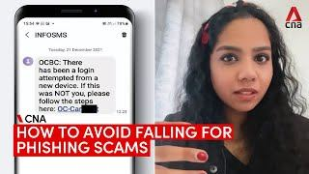

TECHNICAL ANALYSIS
MODEL
Malware-enabled scam signal model
Channel
Pressure and action
Decision rule
Identify how the approach arrived and whether the account or number is independently known.
Separate emotional pressure from the concrete request for data, access or money.
Move to a trusted channel before any disclosure, installation, authentication or payment.
Move to a trusted channel before any disclosure, installation, authentication or payment.
Decision rule
© Tertiary Infotech Academy Pte Ltd | UEN 201200696W | TGS-2024043420
https://www.occ.gov/topics/consumers-and-communities/consumer-protection/fraud-resources/online-and-digital-scams.html

Slide 55


TECHNICAL ANALYSIS
CASE
Malware-enabled scam case decision
Claim
Evidence
Disposition
State only what the sender claims; do not treat identity cues as verified.
Record domain, number, URL, payment route, authentication request and timing.
Block and report when independent verification fails or high-risk actions are requested.
Block and report when independent verification fails or high-risk actions are requested.
Decision rule
© Tertiary Infotech Academy Pte Ltd | UEN 201200696W | TGS-2024043420
https://www.fortinet.com/resources/cyberglossary/internet-fraud

Slide 56


TECHNICAL ANALYSIS
ARCH
QR phishing attack chain
Entry mechanism
Asset and loss path
Observable evidence
Malicious QR destination
hidden redirect to fake service
unverifiable code; payment/login request; domain mismatch
unverifiable code; payment/login request; domain mismatch
Decision rule
© Tertiary Infotech Academy Pte Ltd | UEN 201200696W | TGS-2024043420
https://www.police.gov.sg/-/media/SPF/Media-Room/Statistics/Annual-Scams-and-Cybercrime-Brief-2025/Annual-Scam-and-Cybercrime-Brief-2025.pdf

Slide 57


TECHNICAL ANALYSIS
MODEL
QR phishing signal model
Channel
Pressure and action
Decision rule
Identify how the approach arrived and whether the account or number is independently known.
Separate emotional pressure from the concrete request for data, access or money.
Move to a trusted channel before any disclosure, installation, authentication or payment.
Move to a trusted channel before any disclosure, installation, authentication or payment.
Decision rule
© Tertiary Infotech Academy Pte Ltd | UEN 201200696W | TGS-2024043420
https://www.occ.gov/topics/consumers-and-communities/consumer-protection/fraud-resources/online-and-digital-scams.html

Slide 58


TECHNICAL ANALYSIS
CASE
QR phishing case decision
Claim
Evidence
Disposition
State only what the sender claims; do not treat identity cues as verified.
Record domain, number, URL, payment route, authentication request and timing.
Block and report when independent verification fails or high-risk actions are requested.
Block and report when independent verification fails or high-risk actions are requested.
Decision rule
© Tertiary Infotech Academy Pte Ltd | UEN 201200696W | TGS-2024043420
https://www.fortinet.com/resources/cyberglossary/internet-fraud

Slide 59


TECHNICAL ANALYSIS
ARCH
Account takeover attack chain
Entry mechanism
Asset and loss path
Observable evidence
Stolen credentials or session
impersonation and onward fraud
new device; recovery change; unusual messages
new device; recovery change; unusual messages
Decision rule
© Tertiary Infotech Academy Pte Ltd | UEN 201200696W | TGS-2024043420
https://www.police.gov.sg/-/media/SPF/Media-Room/Statistics/Annual-Scams-and-Cybercrime-Brief-2025/Annual-Scam-and-Cybercrime-Brief-2025.pdf

Slide 60


TECHNICAL ANALYSIS
MODEL
Account takeover signal model
Channel
Pressure and action
Decision rule
Identify how the approach arrived and whether the account or number is independently known.
Separate emotional pressure from the concrete request for data, access or money.
Move to a trusted channel before any disclosure, installation, authentication or payment.
Move to a trusted channel before any disclosure, installation, authentication or payment.
Decision rule
© Tertiary Infotech Academy Pte Ltd | UEN 201200696W | TGS-2024043420
https://www.occ.gov/topics/consumers-and-communities/consumer-protection/fraud-resources/online-and-digital-scams.html

Slide 61


TECHNICAL ANALYSIS
CASE
Account takeover case decision
Claim
Evidence
Disposition
State only what the sender claims; do not treat identity cues as verified.
Record domain, number, URL, payment route, authentication request and timing.
Block and report when independent verification fails or high-risk actions are requested.
Block and report when independent verification fails or high-risk actions are requested.
Decision rule
© Tertiary Infotech Academy Pte Ltd | UEN 201200696W | TGS-2024043420
https://www.fortinet.com/resources/cyberglossary/internet-fraud

Slide 62


TECHNICAL ANALYSIS
ARCH
Money-mule recruitment attack chain
Entry mechanism
Asset and loss path
Observable evidence
Use of personal accounts to move funds
laundering and legal exposure
keep commission; receive and forward; secrecy
keep commission; receive and forward; secrecy
Decision rule
© Tertiary Infotech Academy Pte Ltd | UEN 201200696W | TGS-2024043420
https://www.police.gov.sg/-/media/SPF/Media-Room/Statistics/Annual-Scams-and-Cybercrime-Brief-2025/Annual-Scam-and-Cybercrime-Brief-2025.pdf

Slide 63


TECHNICAL ANALYSIS
MODEL
Money-mule recruitment signal model
Channel
Pressure and action
Decision rule
Identify how the approach arrived and whether the account or number is independently known.
Separate emotional pressure from the concrete request for data, access or money.
Move to a trusted channel before any disclosure, installation, authentication or payment.
Move to a trusted channel before any disclosure, installation, authentication or payment.
Decision rule
© Tertiary Infotech Academy Pte Ltd | UEN 201200696W | TGS-2024043420
https://www.occ.gov/topics/consumers-and-communities/consumer-protection/fraud-resources/online-and-digital-scams.html

Slide 64


TECHNICAL ANALYSIS
CASE
Money-mule recruitment case decision
Claim
Evidence
Disposition
State only what the sender claims; do not treat identity cues as verified.
Record domain, number, URL, payment route, authentication request and timing.
Block and report when independent verification fails or high-risk actions are requested.
Block and report when independent verification fails or high-risk actions are requested.
Decision rule
© Tertiary Infotech Academy Pte Ltd | UEN 201200696W | TGS-2024043420
https://www.fortinet.com/resources/cyberglossary/internet-fraud

Slide 65


TECHNICAL ANALYSIS
ARCH
Lottery and prize scam attack chain
Entry mechanism
Asset and loss path
Observable evidence
False reward notification
fee and identity extraction
unexpected win; tax or delivery fee; urgency
unexpected win; tax or delivery fee; urgency
Decision rule
© Tertiary Infotech Academy Pte Ltd | UEN 201200696W | TGS-2024043420
https://www.police.gov.sg/-/media/SPF/Media-Room/Statistics/Annual-Scams-and-Cybercrime-Brief-2025/Annual-Scam-and-Cybercrime-Brief-2025.pdf

Slide 66


TECHNICAL ANALYSIS
MODEL
Lottery and prize scam signal model
Channel
Pressure and action
Decision rule
Identify how the approach arrived and whether the account or number is independently known.
Separate emotional pressure from the concrete request for data, access or money.
Move to a trusted channel before any disclosure, installation, authentication or payment.
Move to a trusted channel before any disclosure, installation, authentication or payment.
Decision rule
© Tertiary Infotech Academy Pte Ltd | UEN 201200696W | TGS-2024043420
https://www.occ.gov/topics/consumers-and-communities/consumer-protection/fraud-resources/online-and-digital-scams.html

Slide 67


TECHNICAL ANALYSIS
CASE
Lottery and prize scam case decision
Claim
Evidence
Disposition
State only what the sender claims; do not treat identity cues as verified.
Record domain, number, URL, payment route, authentication request and timing.
Block and report when independent verification fails or high-risk actions are requested.
Block and report when independent verification fails or high-risk actions are requested.
Decision rule
© Tertiary Infotech Academy Pte Ltd | UEN 201200696W | TGS-2024043420
https://www.fortinet.com/resources/cyberglossary/internet-fraud

Slide 68


TECHNICAL ANALYSIS
ARCH
Loan scam attack chain
Entry mechanism
Asset and loss path
Observable evidence
False low-cost credit offer
advance fee and identity theft
guaranteed approval; processing fee; unofficial channel
guaranteed approval; processing fee; unofficial channel
Decision rule
© Tertiary Infotech Academy Pte Ltd | UEN 201200696W | TGS-2024043420
https://www.police.gov.sg/-/media/SPF/Media-Room/Statistics/Annual-Scams-and-Cybercrime-Brief-2025/Annual-Scam-and-Cybercrime-Brief-2025.pdf

Slide 69


TECHNICAL ANALYSIS
MODEL
Loan scam signal model
Channel
Pressure and action
Decision rule
Identify how the approach arrived and whether the account or number is independently known.
Separate emotional pressure from the concrete request for data, access or money.
Move to a trusted channel before any disclosure, installation, authentication or payment.
Move to a trusted channel before any disclosure, installation, authentication or payment.
Decision rule
© Tertiary Infotech Academy Pte Ltd | UEN 201200696W | TGS-2024043420
https://www.occ.gov/topics/consumers-and-communities/consumer-protection/fraud-resources/online-and-digital-scams.html

Slide 70


TECHNICAL ANALYSIS
CASE
Loan scam case decision
Claim
Evidence
Disposition
State only what the sender claims; do not treat identity cues as verified.
Record domain, number, URL, payment route, authentication request and timing.
Block and report when independent verification fails or high-risk actions are requested.
Block and report when independent verification fails or high-risk actions are requested.
Decision rule
© Tertiary Infotech Academy Pte Ltd | UEN 201200696W | TGS-2024043420
https://www.fortinet.com/resources/cyberglossary/internet-fraud

Slide 71


TECHNICAL ANALYSIS
ARCH
Deepfake impersonation attack chain
Entry mechanism
Asset and loss path
Observable evidence
Synthetic voice or video
high-trust payment manipulation
unusual request; channel shift; no independent callback
unusual request; channel shift; no independent callback
Decision rule
© Tertiary Infotech Academy Pte Ltd | UEN 201200696W | TGS-2024043420
https://www.police.gov.sg/-/media/SPF/Media-Room/Statistics/Annual-Scams-and-Cybercrime-Brief-2025/Annual-Scam-and-Cybercrime-Brief-2025.pdf

Slide 72


TECHNICAL ANALYSIS
MODEL
Deepfake impersonation signal model
Channel
Pressure and action
Decision rule
Identify how the approach arrived and whether the account or number is independently known.
Separate emotional pressure from the concrete request for data, access or money.
Move to a trusted channel before any disclosure, installation, authentication or payment.
Move to a trusted channel before any disclosure, installation, authentication or payment.
Decision rule
© Tertiary Infotech Academy Pte Ltd | UEN 201200696W | TGS-2024043420
https://www.occ.gov/topics/consumers-and-communities/consumer-protection/fraud-resources/online-and-digital-scams.html

Slide 73


TECHNICAL ANALYSIS
CASE
Deepfake impersonation case decision
Claim
Evidence
Disposition
State only what the sender claims; do not treat identity cues as verified.
Record domain, number, URL, payment route, authentication request and timing.
Block and report when independent verification fails or high-risk actions are requested.
Block and report when independent verification fails or high-risk actions are requested.
Decision rule
© Tertiary Infotech Academy Pte Ltd | UEN 201200696W | TGS-2024043420
https://www.fortinet.com/resources/cyberglossary/internet-fraud

Slide 74
Topic 2 Assessing and Protecting Information
Layer identity, device, account and payment controls around the routes scammers exploit.
© Tertiary Infotech Academy Pte Ltd | UEN 201200696W | TGS-2024043420

Slide 75


TECHNICAL ANALYSIS
CONFIG
Independent verification
Configuration intent
Attack path interrupted
Verification evidence
Move to contact data obtained outside the suspicious message
Breaks the scammer-controlled trust path
Capture the enabled state, owner, timestamp and residual risk without exposing secrets.
Capture the enabled state, owner, timestamp and residual risk without exposing secrets.
Decision rule
© Tertiary Infotech Academy Pte Ltd | UEN 201200696W | TGS-2024043420
https://www.bitdefender.com/en-us/business/infozone/what-is-cyber-fraud

Slide 76


TECHNICAL ANALYSIS
EVIDENCE
Independent verification control test
Scenario trigger
Expected evidence
Failure response
Apply the control to a simulated urgent request, unusual login or changed payment instruction.
The workflow blocks, challenges, limits or rapidly detects the action.
Escalate when the control is absent, bypassed, misconfigured or produces ambiguous evidence.
Escalate when the control is absent, bypassed, misconfigured or produces ambiguous evidence.
Decision rule
© Tertiary Infotech Academy Pte Ltd | UEN 201200696W | TGS-2024043420
https://www.scamshield.gov.sg/

Slide 77


TECHNICAL ANALYSIS
CONFIG
Passkeys and phishing-resistant MFA
Configuration intent
Attack path interrupted
Verification evidence
Bind authentication to the legitimate origin and device
Reduces credential replay and OTP interception
Capture the enabled state, owner, timestamp and residual risk without exposing secrets.
Capture the enabled state, owner, timestamp and residual risk without exposing secrets.
Decision rule
© Tertiary Infotech Academy Pte Ltd | UEN 201200696W | TGS-2024043420
https://www.bitdefender.com/en-us/business/infozone/what-is-cyber-fraud

Slide 78


TECHNICAL ANALYSIS
EVIDENCE
Passkeys and phishing-resistant MFA control test
Scenario trigger
Expected evidence
Failure response
Apply the control to a simulated urgent request, unusual login or changed payment instruction.
The workflow blocks, challenges, limits or rapidly detects the action.
Escalate when the control is absent, bypassed, misconfigured or produces ambiguous evidence.
Escalate when the control is absent, bypassed, misconfigured or produces ambiguous evidence.
Decision rule
© Tertiary Infotech Academy Pte Ltd | UEN 201200696W | TGS-2024043420
https://www.scamshield.gov.sg/

Slide 79


TECHNICAL ANALYSIS
CONFIG
Password manager
Configuration intent
Attack path interrupted
Verification evidence
Generate unique credentials and match saved origins
Prevents password reuse and exposes look-alike domains
Capture the enabled state, owner, timestamp and residual risk without exposing secrets.
Capture the enabled state, owner, timestamp and residual risk without exposing secrets.
Decision rule
© Tertiary Infotech Academy Pte Ltd | UEN 201200696W | TGS-2024043420
https://www.bitdefender.com/en-us/business/infozone/what-is-cyber-fraud

Slide 80


TECHNICAL ANALYSIS
EVIDENCE
Password manager control test
Scenario trigger
Expected evidence
Failure response
Apply the control to a simulated urgent request, unusual login or changed payment instruction.
The workflow blocks, challenges, limits or rapidly detects the action.
Escalate when the control is absent, bypassed, misconfigured or produces ambiguous evidence.
Escalate when the control is absent, bypassed, misconfigured or produces ambiguous evidence.
Decision rule
© Tertiary Infotech Academy Pte Ltd | UEN 201200696W | TGS-2024043420
https://www.scamshield.gov.sg/

Slide 81


TECHNICAL ANALYSIS
CONFIG
Device patching
Configuration intent
Attack path interrupted
Verification evidence
Apply supported operating-system and browser fixes
Removes known exploit paths used by malicious sites and apps
Capture the enabled state, owner, timestamp and residual risk without exposing secrets.
Capture the enabled state, owner, timestamp and residual risk without exposing secrets.
Decision rule
© Tertiary Infotech Academy Pte Ltd | UEN 201200696W | TGS-2024043420
https://www.bitdefender.com/en-us/business/infozone/what-is-cyber-fraud

Slide 82


TECHNICAL ANALYSIS
EVIDENCE
Device patching control test
Scenario trigger
Expected evidence
Failure response
Apply the control to a simulated urgent request, unusual login or changed payment instruction.
The workflow blocks, challenges, limits or rapidly detects the action.
Escalate when the control is absent, bypassed, misconfigured or produces ambiguous evidence.
Escalate when the control is absent, bypassed, misconfigured or produces ambiguous evidence.
Decision rule
© Tertiary Infotech Academy Pte Ltd | UEN 201200696W | TGS-2024043420
https://www.scamshield.gov.sg/

Slide 83


TECHNICAL ANALYSIS
CONFIG
Unknown-source restriction
Configuration intent
Attack path interrupted
Verification evidence
Block sideloading and risky accessibility permissions
Interrupts malware-enabled scam installation
Capture the enabled state, owner, timestamp and residual risk without exposing secrets.
Capture the enabled state, owner, timestamp and residual risk without exposing secrets.
Decision rule
© Tertiary Infotech Academy Pte Ltd | UEN 201200696W | TGS-2024043420
https://www.bitdefender.com/en-us/business/infozone/what-is-cyber-fraud

Slide 84


TECHNICAL ANALYSIS
EVIDENCE
Unknown-source restriction control test
Scenario trigger
Expected evidence
Failure response
Apply the control to a simulated urgent request, unusual login or changed payment instruction.
The workflow blocks, challenges, limits or rapidly detects the action.
Escalate when the control is absent, bypassed, misconfigured or produces ambiguous evidence.
Escalate when the control is absent, bypassed, misconfigured or produces ambiguous evidence.
Decision rule
© Tertiary Infotech Academy Pte Ltd | UEN 201200696W | TGS-2024043420
https://www.scamshield.gov.sg/

Slide 85


TECHNICAL ANALYSIS
CONFIG
Session review
Configuration intent
Attack path interrupted
Verification evidence
Inspect devices, sessions, forwarding and recovery changes
Detects persistence after credential compromise
Capture the enabled state, owner, timestamp and residual risk without exposing secrets.
Capture the enabled state, owner, timestamp and residual risk without exposing secrets.
Decision rule
© Tertiary Infotech Academy Pte Ltd | UEN 201200696W | TGS-2024043420
https://www.bitdefender.com/en-us/business/infozone/what-is-cyber-fraud

Slide 86


TECHNICAL ANALYSIS
EVIDENCE
Session review control test
Scenario trigger
Expected evidence
Failure response
Apply the control to a simulated urgent request, unusual login or changed payment instruction.
The workflow blocks, challenges, limits or rapidly detects the action.
Escalate when the control is absent, bypassed, misconfigured or produces ambiguous evidence.
Escalate when the control is absent, bypassed, misconfigured or produces ambiguous evidence.
Decision rule
© Tertiary Infotech Academy Pte Ltd | UEN 201200696W | TGS-2024043420
https://www.scamshield.gov.sg/

Slide 87


TECHNICAL ANALYSIS
CONFIG
Transaction alerts
Configuration intent
Attack path interrupted
Verification evidence
Notify immediately on transfers, payees and card activity
Shortens detection and bank-contact time
Capture the enabled state, owner, timestamp and residual risk without exposing secrets.
Capture the enabled state, owner, timestamp and residual risk without exposing secrets.
Decision rule
© Tertiary Infotech Academy Pte Ltd | UEN 201200696W | TGS-2024043420
https://www.bitdefender.com/en-us/business/infozone/what-is-cyber-fraud

Slide 88


TECHNICAL ANALYSIS
EVIDENCE
Transaction alerts control test
Scenario trigger
Expected evidence
Failure response
Apply the control to a simulated urgent request, unusual login or changed payment instruction.
The workflow blocks, challenges, limits or rapidly detects the action.
Escalate when the control is absent, bypassed, misconfigured or produces ambiguous evidence.
Escalate when the control is absent, bypassed, misconfigured or produces ambiguous evidence.
Decision rule
© Tertiary Infotech Academy Pte Ltd | UEN 201200696W | TGS-2024043420
https://www.scamshield.gov.sg/

Slide 89


TECHNICAL ANALYSIS
CONFIG
Transfer limits
Configuration intent
Attack path interrupted
Verification evidence
Cap routine exposure and require deliberate changes
Reduces maximum loss from one compromised session
Capture the enabled state, owner, timestamp and residual risk without exposing secrets.
Capture the enabled state, owner, timestamp and residual risk without exposing secrets.
Decision rule
© Tertiary Infotech Academy Pte Ltd | UEN 201200696W | TGS-2024043420
https://www.bitdefender.com/en-us/business/infozone/what-is-cyber-fraud

Slide 90


TECHNICAL ANALYSIS
EVIDENCE
Transfer limits control test
Scenario trigger
Expected evidence
Failure response
Apply the control to a simulated urgent request, unusual login or changed payment instruction.
The workflow blocks, challenges, limits or rapidly detects the action.
Escalate when the control is absent, bypassed, misconfigured or produces ambiguous evidence.
Escalate when the control is absent, bypassed, misconfigured or produces ambiguous evidence.
Decision rule
© Tertiary Infotech Academy Pte Ltd | UEN 201200696W | TGS-2024043420
https://www.scamshield.gov.sg/

Slide 91


TECHNICAL ANALYSIS
CONFIG
Money Lock
Configuration intent
Attack path interrupted
Verification evidence
Separate protected funds from digitally transferable balances
Limits funds reachable through online compromise
Capture the enabled state, owner, timestamp and residual risk without exposing secrets.
Capture the enabled state, owner, timestamp and residual risk without exposing secrets.
Decision rule
© Tertiary Infotech Academy Pte Ltd | UEN 201200696W | TGS-2024043420
https://www.bitdefender.com/en-us/business/infozone/what-is-cyber-fraud

Slide 92


TECHNICAL ANALYSIS
EVIDENCE
Money Lock control test
Scenario trigger
Expected evidence
Failure response
Apply the control to a simulated urgent request, unusual login or changed payment instruction.
The workflow blocks, challenges, limits or rapidly detects the action.
Escalate when the control is absent, bypassed, misconfigured or produces ambiguous evidence.
Escalate when the control is absent, bypassed, misconfigured or produces ambiguous evidence.
Decision rule
© Tertiary Infotech Academy Pte Ltd | UEN 201200696W | TGS-2024043420
https://www.scamshield.gov.sg/

Slide 93


TECHNICAL ANALYSIS
CONFIG
Maker-checker approval
Configuration intent
Attack path interrupted
Verification evidence
Separate request, verification and payment release
Stops a single compromised mailbox from authorising payment
Capture the enabled state, owner, timestamp and residual risk without exposing secrets.
Capture the enabled state, owner, timestamp and residual risk without exposing secrets.
Decision rule
© Tertiary Infotech Academy Pte Ltd | UEN 201200696W | TGS-2024043420
https://www.bitdefender.com/en-us/business/infozone/what-is-cyber-fraud

Slide 94

TECHNICAL ANALYSIS
EVIDENCE
Maker-checker approval control test
Scenario trigger
Expected evidence
Failure response
Apply the control to a simulated urgent request, unusual login or changed payment instruction.
The workflow blocks, challenges, limits or rapidly detects the action.
Escalate when the control is absent, bypassed, misconfigured or produces ambiguous evidence.
Escalate when the control is absent, bypassed, misconfigured or produces ambiguous evidence.
Decision rule
© Tertiary Infotech Academy Pte Ltd | UEN 201200696W | TGS-2024043420
https://www.scamshield.gov.sg/

Slide 95
TECHNICAL ANALYSIS
CONFIG
Beneficiary callback
Configuration intent
Attack path interrupted
Verification evidence
Verify account changes through a known channel
Targets business email compromise and invoice diversion
Capture the enabled state, owner, timestamp and residual risk without exposing secrets.
Capture the enabled state, owner, timestamp and residual risk without exposing secrets.
Decision rule
© Tertiary Infotech Academy Pte Ltd | UEN 201200696W | TGS-2024043420
https://www.bitdefender.com/en-us/business/infozone/what-is-cyber-fraud

Slide 96
TECHNICAL ANALYSIS
EVIDENCE
Beneficiary callback control test
Scenario trigger
Expected evidence
Failure response
Apply the control to a simulated urgent request, unusual login or changed payment instruction.
The workflow blocks, challenges, limits or rapidly detects the action.
Escalate when the control is absent, bypassed, misconfigured or produces ambiguous evidence.
Escalate when the control is absent, bypassed, misconfigured or produces ambiguous evidence.
Decision rule
© Tertiary Infotech Academy Pte Ltd | UEN 201200696W | TGS-2024043420
https://www.scamshield.gov.sg/

Slide 97
TECHNICAL ANALYSIS
CONFIG
ScamShield
Configuration intent
Attack path interrupted
Verification evidence
Check and report suspicious numbers, messages and links
Adds community and SPF-informed detection signals
Capture the enabled state, owner, timestamp and residual risk without exposing secrets.
Capture the enabled state, owner, timestamp and residual risk without exposing secrets.
Decision rule
© Tertiary Infotech Academy Pte Ltd | UEN 201200696W | TGS-2024043420
https://www.bitdefender.com/en-us/business/infozone/what-is-cyber-fraud

Slide 98
TECHNICAL ANALYSIS
EVIDENCE
ScamShield control test
Scenario trigger
Expected evidence
Failure response
Apply the control to a simulated urgent request, unusual login or changed payment instruction.
The workflow blocks, challenges, limits or rapidly detects the action.
Escalate when the control is absent, bypassed, misconfigured or produces ambiguous evidence.
Escalate when the control is absent, bypassed, misconfigured or produces ambiguous evidence.
Decision rule
© Tertiary Infotech Academy Pte Ltd | UEN 201200696W | TGS-2024043420
https://www.scamshield.gov.sg/

Slide 99
TECHNICAL ANALYSIS
CONFIG
Privacy minimisation
Configuration intent
Attack path interrupted
Verification evidence
Limit public identity, role and relationship data
Reduces material available for tailored pretexts
Capture the enabled state, owner, timestamp and residual risk without exposing secrets.
Capture the enabled state, owner, timestamp and residual risk without exposing secrets.
Decision rule
© Tertiary Infotech Academy Pte Ltd | UEN 201200696W | TGS-2024043420
https://www.bitdefender.com/en-us/business/infozone/what-is-cyber-fraud

Slide 100
TECHNICAL ANALYSIS
EVIDENCE
Privacy minimisation control test
Scenario trigger
Expected evidence
Failure response
Apply the control to a simulated urgent request, unusual login or changed payment instruction.
The workflow blocks, challenges, limits or rapidly detects the action.
Escalate when the control is absent, bypassed, misconfigured or produces ambiguous evidence.
Escalate when the control is absent, bypassed, misconfigured or produces ambiguous evidence.
Decision rule
© Tertiary Infotech Academy Pte Ltd | UEN 201200696W | TGS-2024043420
https://www.scamshield.gov.sg/

Slide 101
TECHNICAL ANALYSIS
CONFIG
Offline backup
Configuration intent
Attack path interrupted
Verification evidence
Keep tested, disconnected recovery copies
Reduces ransomware leverage and preserves business continuity
Capture the enabled state, owner, timestamp and residual risk without exposing secrets.
Capture the enabled state, owner, timestamp and residual risk without exposing secrets.
Decision rule
© Tertiary Infotech Academy Pte Ltd | UEN 201200696W | TGS-2024043420
https://www.bitdefender.com/en-us/business/infozone/what-is-cyber-fraud

Slide 102
TECHNICAL ANALYSIS
EVIDENCE
Offline backup control test
Scenario trigger
Expected evidence
Failure response
Apply the control to a simulated urgent request, unusual login or changed payment instruction.
The workflow blocks, challenges, limits or rapidly detects the action.
Escalate when the control is absent, bypassed, misconfigured or produces ambiguous evidence.
Escalate when the control is absent, bypassed, misconfigured or produces ambiguous evidence.
Decision rule
© Tertiary Infotech Academy Pte Ltd | UEN 201200696W | TGS-2024043420
https://www.scamshield.gov.sg/

Slide 103
TECHNICAL ANALYSIS
CONFIG
Incident rehearsal
Configuration intent
Attack path interrupted
Verification evidence
Practice evidence, bank, police and internal escalation
Reduces delay and omissions under pressure
Capture the enabled state, owner, timestamp and residual risk without exposing secrets.
Capture the enabled state, owner, timestamp and residual risk without exposing secrets.
Decision rule
© Tertiary Infotech Academy Pte Ltd | UEN 201200696W | TGS-2024043420
https://www.bitdefender.com/en-us/business/infozone/what-is-cyber-fraud

Slide 104
TECHNICAL ANALYSIS
EVIDENCE
Incident rehearsal control test
Scenario trigger
Expected evidence
Failure response
Apply the control to a simulated urgent request, unusual login or changed payment instruction.
The workflow blocks, challenges, limits or rapidly detects the action.
Escalate when the control is absent, bypassed, misconfigured or produces ambiguous evidence.
Escalate when the control is absent, bypassed, misconfigured or produces ambiguous evidence.
Decision rule
© Tertiary Infotech Academy Pte Ltd | UEN 201200696W | TGS-2024043420
https://www.scamshield.gov.sg/

Slide 105
TECHNICAL ANALYSIS
ACTIVITY
Activity 1 bridge: Scam Signal Triage
Objective
Evidence
Acceptance
Classify a suspicious contact using channel, claim, pressure, requested action and payment route.
Completed signal matrix with risk score and decision rationale.
Every decision cites at least two observable indicators; no decision relies only on spelling or grammar.
Every decision cites at least two observable indicators; no decision relies only on spelling or grammar.
Decision rule
© Tertiary Infotech Academy Pte Ltd | UEN 201200696W | TGS-2024043420
activities/activity-01-scam-signal-triage/ACTIVITY-GUIDE.md

Slide 106
TECHNICAL ANALYSIS
ACTIVITY
Activity 2 bridge: Phishing URL and Header Analysis
Objective
Evidence
Acceptance
Inspect a simulated phishing message without opening its link or attachment.
Annotated header and URL decomposition with disposition.
The registrable domain and authentication result are stated correctly and no live suspect link is opened.
The registrable domain and authentication result are stated correctly and no live suspect link is opened.
Decision rule
© Tertiary Infotech Academy Pte Ltd | UEN 201200696W | TGS-2024043420
activities/activity-02-phishing-url-header-analysis/ACTIVITY-GUIDE.md

Slide 107
TECHNICAL ANALYSIS
ACTIVITY
Activity 3 bridge: Independent Verification Drill
Objective
Evidence
Acceptance
Break the scammer-controlled channel and verify a claim through trusted contact data.
Verification log and trust-boundary explanation.
No sender-provided telephone number, link or QR code is used for verification.
No sender-provided telephone number, link or QR code is used for verification.
Decision rule
© Tertiary Infotech Academy Pte Ltd | UEN 201200696W | TGS-2024043420
activities/activity-03-independent-verification/ACTIVITY-GUIDE.md

Slide 108
TECHNICAL ANALYSIS
ACTIVITY
Activity 4 bridge: Account and Device Hardening
Objective
Evidence
Acceptance
Apply layered safeguards that reduce credential, session and malware-enabled fraud.
Hardening checklist with redacted screenshots and residual risks.
Credentials and recovery codes are absent; each control names the attack path it interrupts.
Credentials and recovery codes are absent; each control names the attack path it interrupts.
Decision rule
© Tertiary Infotech Academy Pte Ltd | UEN 201200696W | TGS-2024043420
activities/activity-04-account-device-hardening/ACTIVITY-GUIDE.md

Slide 109
TECHNICAL ANALYSIS
ACTIVITY
Activity 5 bridge: ScamShield Check and Report
Objective
Evidence
Acceptance
Use ScamShield resources to check and report a simulated suspicious message safely.
ScamShield check record, redacted report example and limitations note.
Only simulated data is submitted; the learner distinguishes a tool result from proof of legitimacy.
Only simulated data is submitted; the learner distinguishes a tool result from proof of legitimacy.
Decision rule
© Tertiary Infotech Academy Pte Ltd | UEN 201200696W | TGS-2024043420
activities/activity-05-scamshield-check-report/ACTIVITY-GUIDE.md

Slide 110
TECHNICAL ANALYSIS
ACTIVITY
Activity 6 bridge: Financial Control Plan
Objective
Evidence
Acceptance
Design preventive and detective controls for a personal or small-business payment workflow.
Payment control map, approval matrix and scenario test result.
The design separates request, verification and approval, and names at least one preventive and one detective control.
The design separates request, verification and approval, and names at least one preventive and one detective control.
Decision rule
© Tertiary Infotech Academy Pte Ltd | UEN 201200696W | TGS-2024043420
activities/activity-06-financial-control-plan/ACTIVITY-GUIDE.md

Slide 111
Topic 3 Responding to Cyber Security Threats
Contain loss, preserve evidence and route verified facts to the parties who can act.
© Tertiary Infotech Academy Pte Ltd | UEN 201200696W | TGS-2024043420

Slide 112

© Tertiary Infotech Academy Pte Ltd | UEN 201200696W | TGS-2024043420
https://www.scamshield.gov.sg/

Slide 113
TECHNICAL ANALYSIS
PROCESS
Stop interaction
Required action
Operational reason
Evidence to retain
End calls and messages; do not follow new instructions
prevents further coercion and data disclosure
Record time, owner, reference number, source item and observable outcome.
Record time, owner, reference number, source item and observable outcome.
Decision rule
© Tertiary Infotech Academy Pte Ltd | UEN 201200696W | TGS-2024043420
https://www.scamshield.gov.sg/

Slide 114
TECHNICAL ANALYSIS
DECISION
Stop interaction escalation check
Severity
Routing
Handoff test
Assess financial loss, account or device compromise, personal data, affected people and business impact.
Notify the bank, platform, ScamShield, Police and internal teams according to the facts and impact.
The recipient can act because the brief contains chronology, evidence IDs, confirmed facts and a clear request.
The recipient can act because the brief contains chronology, evidence IDs, confirmed facts and a clear request.
Decision rule
© Tertiary Infotech Academy Pte Ltd | UEN 201200696W | TGS-2024043420
https://www.police.gov.sg/-/media/SPF/Media-Room/Statistics/Mid-Year-Scam-and-Cybercrime-Brief-2026/Mid-Year-Scam-and-Cybercrime-Brief-2026.pdf

Slide 115
TECHNICAL ANALYSIS
PROCESS
Protect money
Required action
Operational reason
Evidence to retain
Contact the bank through an official channel and request urgent action
maximises the chance of stopping or tracing transfers
Record time, owner, reference number, source item and observable outcome.
Record time, owner, reference number, source item and observable outcome.
Decision rule
© Tertiary Infotech Academy Pte Ltd | UEN 201200696W | TGS-2024043420
https://www.scamshield.gov.sg/

Slide 116
TECHNICAL ANALYSIS
DECISION
Protect money escalation check
Severity
Routing
Handoff test
Assess financial loss, account or device compromise, personal data, affected people and business impact.
Notify the bank, platform, ScamShield, Police and internal teams according to the facts and impact.
The recipient can act because the brief contains chronology, evidence IDs, confirmed facts and a clear request.
The recipient can act because the brief contains chronology, evidence IDs, confirmed facts and a clear request.
Decision rule
© Tertiary Infotech Academy Pte Ltd | UEN 201200696W | TGS-2024043420
https://www.police.gov.sg/-/media/SPF/Media-Room/Statistics/Mid-Year-Scam-and-Cybercrime-Brief-2026/Mid-Year-Scam-and-Cybercrime-Brief-2026.pdf

Slide 117
TECHNICAL ANALYSIS
PROCESS
Isolate compromise
Required action
Operational reason
Evidence to retain
Disconnect a suspected infected device while preserving state
limits attacker access without erasing evidence
Record time, owner, reference number, source item and observable outcome.
Record time, owner, reference number, source item and observable outcome.
Decision rule
© Tertiary Infotech Academy Pte Ltd | UEN 201200696W | TGS-2024043420
https://www.scamshield.gov.sg/

Slide 118
TECHNICAL ANALYSIS
DECISION
Isolate compromise escalation check
Severity
Routing
Handoff test
Assess financial loss, account or device compromise, personal data, affected people and business impact.
Notify the bank, platform, ScamShield, Police and internal teams according to the facts and impact.
The recipient can act because the brief contains chronology, evidence IDs, confirmed facts and a clear request.
The recipient can act because the brief contains chronology, evidence IDs, confirmed facts and a clear request.
Decision rule
© Tertiary Infotech Academy Pte Ltd | UEN 201200696W | TGS-2024043420
https://www.police.gov.sg/-/media/SPF/Media-Room/Statistics/Mid-Year-Scam-and-Cybercrime-Brief-2026/Mid-Year-Scam-and-Cybercrime-Brief-2026.pdf

Slide 119
TECHNICAL ANALYSIS
PROCESS
Preserve evidence
Required action
Operational reason
Evidence to retain
Save originals, screenshots, headers, numbers, URLs and transaction references
supports bank, platform and police action
Record time, owner, reference number, source item and observable outcome.
Record time, owner, reference number, source item and observable outcome.
Decision rule
© Tertiary Infotech Academy Pte Ltd | UEN 201200696W | TGS-2024043420
https://www.scamshield.gov.sg/

Slide 120
TECHNICAL ANALYSIS
DECISION
Preserve evidence escalation check
Severity
Routing
Handoff test
Assess financial loss, account or device compromise, personal data, affected people and business impact.
Notify the bank, platform, ScamShield, Police and internal teams according to the facts and impact.
The recipient can act because the brief contains chronology, evidence IDs, confirmed facts and a clear request.
The recipient can act because the brief contains chronology, evidence IDs, confirmed facts and a clear request.
Decision rule
© Tertiary Infotech Academy Pte Ltd | UEN 201200696W | TGS-2024043420
https://www.police.gov.sg/-/media/SPF/Media-Room/Statistics/Mid-Year-Scam-and-Cybercrime-Brief-2026/Mid-Year-Scam-and-Cybercrime-Brief-2026.pdf

Slide 121
TECHNICAL ANALYSIS
PROCESS
Secure accounts
Required action
Operational reason
Evidence to retain
Change exposed credentials from a trusted device and revoke sessions
closes reused credentials and stolen sessions
Record time, owner, reference number, source item and observable outcome.
Record time, owner, reference number, source item and observable outcome.
Decision rule
© Tertiary Infotech Academy Pte Ltd | UEN 201200696W | TGS-2024043420
https://www.scamshield.gov.sg/

Slide 122
TECHNICAL ANALYSIS
DECISION
Secure accounts escalation check
Severity
Routing
Handoff test
Assess financial loss, account or device compromise, personal data, affected people and business impact.
Notify the bank, platform, ScamShield, Police and internal teams according to the facts and impact.
The recipient can act because the brief contains chronology, evidence IDs, confirmed facts and a clear request.
The recipient can act because the brief contains chronology, evidence IDs, confirmed facts and a clear request.
Decision rule
© Tertiary Infotech Academy Pte Ltd | UEN 201200696W | TGS-2024043420
https://www.police.gov.sg/-/media/SPF/Media-Room/Statistics/Mid-Year-Scam-and-Cybercrime-Brief-2026/Mid-Year-Scam-and-Cybercrime-Brief-2026.pdf

Slide 123
TECHNICAL ANALYSIS
PROCESS
Assess scope
Required action
Operational reason
Evidence to retain
Identify people, accounts, devices, data and payments affected
sets severity and notification priorities
Record time, owner, reference number, source item and observable outcome.
Record time, owner, reference number, source item and observable outcome.
Decision rule
© Tertiary Infotech Academy Pte Ltd | UEN 201200696W | TGS-2024043420
https://www.scamshield.gov.sg/

Slide 124
TECHNICAL ANALYSIS
DECISION
Assess scope escalation check
Severity
Routing
Handoff test
Assess financial loss, account or device compromise, personal data, affected people and business impact.
Notify the bank, platform, ScamShield, Police and internal teams according to the facts and impact.
The recipient can act because the brief contains chronology, evidence IDs, confirmed facts and a clear request.
The recipient can act because the brief contains chronology, evidence IDs, confirmed facts and a clear request.
Decision rule
© Tertiary Infotech Academy Pte Ltd | UEN 201200696W | TGS-2024043420
https://www.police.gov.sg/-/media/SPF/Media-Room/Statistics/Mid-Year-Scam-and-Cybercrime-Brief-2026/Mid-Year-Scam-and-Cybercrime-Brief-2026.pdf

Slide 125
TECHNICAL ANALYSIS
PROCESS
Report platform abuse
Required action
Operational reason
Evidence to retain
Use the platform reporting path for the account, advert, message or listing
enables removal and ecosystem disruption
Record time, owner, reference number, source item and observable outcome.
Record time, owner, reference number, source item and observable outcome.
Decision rule
© Tertiary Infotech Academy Pte Ltd | UEN 201200696W | TGS-2024043420
https://www.scamshield.gov.sg/

Slide 126
TECHNICAL ANALYSIS
DECISION
Report platform abuse escalation check
Severity
Routing
Handoff test
Assess financial loss, account or device compromise, personal data, affected people and business impact.
Notify the bank, platform, ScamShield, Police and internal teams according to the facts and impact.
The recipient can act because the brief contains chronology, evidence IDs, confirmed facts and a clear request.
The recipient can act because the brief contains chronology, evidence IDs, confirmed facts and a clear request.
Decision rule
© Tertiary Infotech Academy Pte Ltd | UEN 201200696W | TGS-2024043420
https://www.police.gov.sg/-/media/SPF/Media-Room/Statistics/Mid-Year-Scam-and-Cybercrime-Brief-2026/Mid-Year-Scam-and-Cybercrime-Brief-2026.pdf

Slide 127
TECHNICAL ANALYSIS
PROCESS
Use ScamShield
Required action
Operational reason
Evidence to retain
Check or report suspicious contact through official ScamShield resources
contributes signals and receives current advice
Record time, owner, reference number, source item and observable outcome.
Record time, owner, reference number, source item and observable outcome.
Decision rule
© Tertiary Infotech Academy Pte Ltd | UEN 201200696W | TGS-2024043420
https://www.scamshield.gov.sg/

Slide 128
TECHNICAL ANALYSIS
DECISION
Use ScamShield escalation check
Severity
Routing
Handoff test
Assess financial loss, account or device compromise, personal data, affected people and business impact.
Notify the bank, platform, ScamShield, Police and internal teams according to the facts and impact.
The recipient can act because the brief contains chronology, evidence IDs, confirmed facts and a clear request.
The recipient can act because the brief contains chronology, evidence IDs, confirmed facts and a clear request.
Decision rule
© Tertiary Infotech Academy Pte Ltd | UEN 201200696W | TGS-2024043420
https://www.police.gov.sg/-/media/SPF/Media-Room/Statistics/Mid-Year-Scam-and-Cybercrime-Brief-2026/Mid-Year-Scam-and-Cybercrime-Brief-2026.pdf

Slide 129
TECHNICAL ANALYSIS
PROCESS
Make a Police report
Required action
Operational reason
Evidence to retain
Provide a factual chronology and supporting evidence
creates an official record and supports investigation
Record time, owner, reference number, source item and observable outcome.
Record time, owner, reference number, source item and observable outcome.
Decision rule
© Tertiary Infotech Academy Pte Ltd | UEN 201200696W | TGS-2024043420
https://www.scamshield.gov.sg/

Slide 130
TECHNICAL ANALYSIS
DECISION
Make a Police report escalation check
Severity
Routing
Handoff test
Assess financial loss, account or device compromise, personal data, affected people and business impact.
Notify the bank, platform, ScamShield, Police and internal teams according to the facts and impact.
The recipient can act because the brief contains chronology, evidence IDs, confirmed facts and a clear request.
The recipient can act because the brief contains chronology, evidence IDs, confirmed facts and a clear request.
Decision rule
© Tertiary Infotech Academy Pte Ltd | UEN 201200696W | TGS-2024043420
https://www.police.gov.sg/-/media/SPF/Media-Room/Statistics/Mid-Year-Scam-and-Cybercrime-Brief-2026/Mid-Year-Scam-and-Cybercrime-Brief-2026.pdf

Slide 131
TECHNICAL ANALYSIS
PROCESS
Notify the workplace
Required action
Operational reason
Evidence to retain
Engage security, finance, legal and data-protection roles as applicable
coordinates containment and statutory decisions
Record time, owner, reference number, source item and observable outcome.
Record time, owner, reference number, source item and observable outcome.
Decision rule
© Tertiary Infotech Academy Pte Ltd | UEN 201200696W | TGS-2024043420
https://www.scamshield.gov.sg/

Slide 132
TECHNICAL ANALYSIS
DECISION
Notify the workplace escalation check
Severity
Routing
Handoff test
Assess financial loss, account or device compromise, personal data, affected people and business impact.
Notify the bank, platform, ScamShield, Police and internal teams according to the facts and impact.
The recipient can act because the brief contains chronology, evidence IDs, confirmed facts and a clear request.
The recipient can act because the brief contains chronology, evidence IDs, confirmed facts and a clear request.
Decision rule
© Tertiary Infotech Academy Pte Ltd | UEN 201200696W | TGS-2024043420
https://www.police.gov.sg/-/media/SPF/Media-Room/Statistics/Mid-Year-Scam-and-Cybercrime-Brief-2026/Mid-Year-Scam-and-Cybercrime-Brief-2026.pdf

Slide 133
TECHNICAL ANALYSIS
PROCESS
Track recovery
Required action
Operational reason
Evidence to retain
Maintain actions, owners, reference numbers and outcomes
prevents gaps and supports handoffs
Record time, owner, reference number, source item and observable outcome.
Record time, owner, reference number, source item and observable outcome.
Decision rule
© Tertiary Infotech Academy Pte Ltd | UEN 201200696W | TGS-2024043420
https://www.scamshield.gov.sg/

Slide 134
TECHNICAL ANALYSIS
DECISION
Track recovery escalation check
Severity
Routing
Handoff test
Assess financial loss, account or device compromise, personal data, affected people and business impact.
Notify the bank, platform, ScamShield, Police and internal teams according to the facts and impact.
The recipient can act because the brief contains chronology, evidence IDs, confirmed facts and a clear request.
The recipient can act because the brief contains chronology, evidence IDs, confirmed facts and a clear request.
Decision rule
© Tertiary Infotech Academy Pte Ltd | UEN 201200696W | TGS-2024043420
https://www.police.gov.sg/-/media/SPF/Media-Room/Statistics/Mid-Year-Scam-and-Cybercrime-Brief-2026/Mid-Year-Scam-and-Cybercrime-Brief-2026.pdf

Slide 135
TECHNICAL ANALYSIS
PROCESS
Review controls
Required action
Operational reason
Evidence to retain
Convert the incident into owned corrective actions
reduces recurrence and tests whether controls work
Record time, owner, reference number, source item and observable outcome.
Record time, owner, reference number, source item and observable outcome.
Decision rule
© Tertiary Infotech Academy Pte Ltd | UEN 201200696W | TGS-2024043420
https://www.scamshield.gov.sg/

Slide 136
TECHNICAL ANALYSIS
DECISION
Review controls escalation check
Severity
Routing
Handoff test
Assess financial loss, account or device compromise, personal data, affected people and business impact.
Notify the bank, platform, ScamShield, Police and internal teams according to the facts and impact.
The recipient can act because the brief contains chronology, evidence IDs, confirmed facts and a clear request.
The recipient can act because the brief contains chronology, evidence IDs, confirmed facts and a clear request.
Decision rule
© Tertiary Infotech Academy Pte Ltd | UEN 201200696W | TGS-2024043420
https://www.police.gov.sg/-/media/SPF/Media-Room/Statistics/Mid-Year-Scam-and-Cybercrime-Brief-2026/Mid-Year-Scam-and-Cybercrime-Brief-2026.pdf

Slide 137
TECHNICAL ANALYSIS
ACTIVITY
Activity 7 bridge: Incident Evidence Pack
Objective
Evidence
Acceptance
Preserve useful evidence and start containment without destroying the incident timeline.
Incident timeline, evidence register and initial containment record.
The chronology is complete, evidence remains unaltered, and containment actions are distinguished from eradication.
The chronology is complete, evidence remains unaltered, and containment actions are distinguished from eradication.
Decision rule
© Tertiary Infotech Academy Pte Ltd | UEN 201200696W | TGS-2024043420
activities/activity-07-incident-evidence-pack/ACTIVITY-GUIDE.md

Slide 138
TECHNICAL ANALYSIS
ACTIVITY
Activity 8 bridge: Escalation Tabletop
Objective
Evidence
Acceptance
Route a scam incident to the right internal and external parties using severity and evidence.
Escalation matrix, incident brief, notification sequence and after-action actions.
The brief separates facts from assumptions and includes timestamps, evidence references, impact and a clear request.
The brief separates facts from assumptions and includes timestamps, evidence references, impact and a clear request.
Decision rule
© Tertiary Infotech Academy Pte Ltd | UEN 201200696W | TGS-2024043420
activities/activity-08-escalation-tabletop/ACTIVITY-GUIDE.md

Slide 139
Assessment and Close
Use the evidence models, controls and escalation decisions practised in the eight activities.
© Tertiary Infotech Academy Pte Ltd | UEN 201200696W | TGS-2024043420

Slide 140
CLOSING
ADMIN
Written Assessment
Purpose
Evidence
Completion
Three open-ended questions mapped to K1–K3.
Use the approved course materials and follow the assessor instructions.
Three open-ended questions mapped to K1–K3.
Three open-ended questions mapped to K1–K3.
Decision rule
© Tertiary Infotech Academy Pte Ltd | UEN 201200696W | TGS-2024043420
https://lms-tms.tertiaryinfotech.com/

Slide 141
CLOSING
ADMIN
Case Study
Purpose
Evidence
Completion
One coherent scenario with three questions mapped to A1–A3.
Use the approved course materials and follow the assessor instructions.
One coherent scenario with three questions mapped to A1–A3.
One coherent scenario with three questions mapped to A1–A3.
Decision rule
© Tertiary Infotech Academy Pte Ltd | UEN 201200696W | TGS-2024043420
https://lms-tms.tertiaryinfotech.com/

Slide 142
CLOSING
ADMIN
Assessment Flow
1
2
3
4
Written Assessment
Case Study
Assessor Review
Sign-off
3 open-ended questions
1 scenario · 3 questions
Evidence and criteria
Feedback and appeal route
K1–K3
A1–A3
C / NYC
Record outcome
Only the question papers are learner-facing. Answer keys remain trainer-only.
© Tertiary Infotech Academy Pte Ltd | UEN 201200696W | TGS-2024043420
https://lms-tms.tertiaryinfotech.com/

Slide 143
CLOSING
ADMIN
Digital Attendance
Purpose
Evidence
Completion
Complete the mandatory assessment attendance using the trainer-provided SSG QR code.
Use the approved course materials and follow the assessor instructions.
Complete the mandatory assessment attendance using the trainer-provided SSG QR code.
Complete the mandatory assessment attendance using the trainer-provided SSG QR code.
Decision rule
© Tertiary Infotech Academy Pte Ltd | UEN 201200696W | TGS-2024043420
https://lms-tms.tertiaryinfotech.com/

Slide 144
CLOSING
ADMIN
TRAQOM and Course Feedback
Purpose
Evidence
Completion
Complete the course feedback and TRAQOM survey in the LMS.
Use the approved course materials and follow the assessor instructions.
Complete the course feedback and TRAQOM survey in the LMS.
Complete the course feedback and TRAQOM survey in the LMS.
Decision rule
© Tertiary Infotech Academy Pte Ltd | UEN 201200696W | TGS-2024043420
https://lms-tms.tertiaryinfotech.com/

Slide 145
CLOSING
ADMIN
Thank You
Purpose
Evidence
Completion
Stay calm, break the attacker-controlled channel, verify independently and preserve evidence.
Use the approved course materials and follow the assessor instructions.
Stay calm, break the attacker-controlled channel, verify independently and preserve evidence.
Stay calm, break the attacker-controlled channel, verify independently and preserve evidence.
Decision rule
© Tertiary Infotech Academy Pte Ltd | UEN 201200696W | TGS-2024043420
https://lms-tms.tertiaryinfotech.com/

